Slide 1
DISTRICT INSTITUTE OF EDUCATION AND TRAINING (DIET), QUILAGHAT DARBHANGA

Slide 2
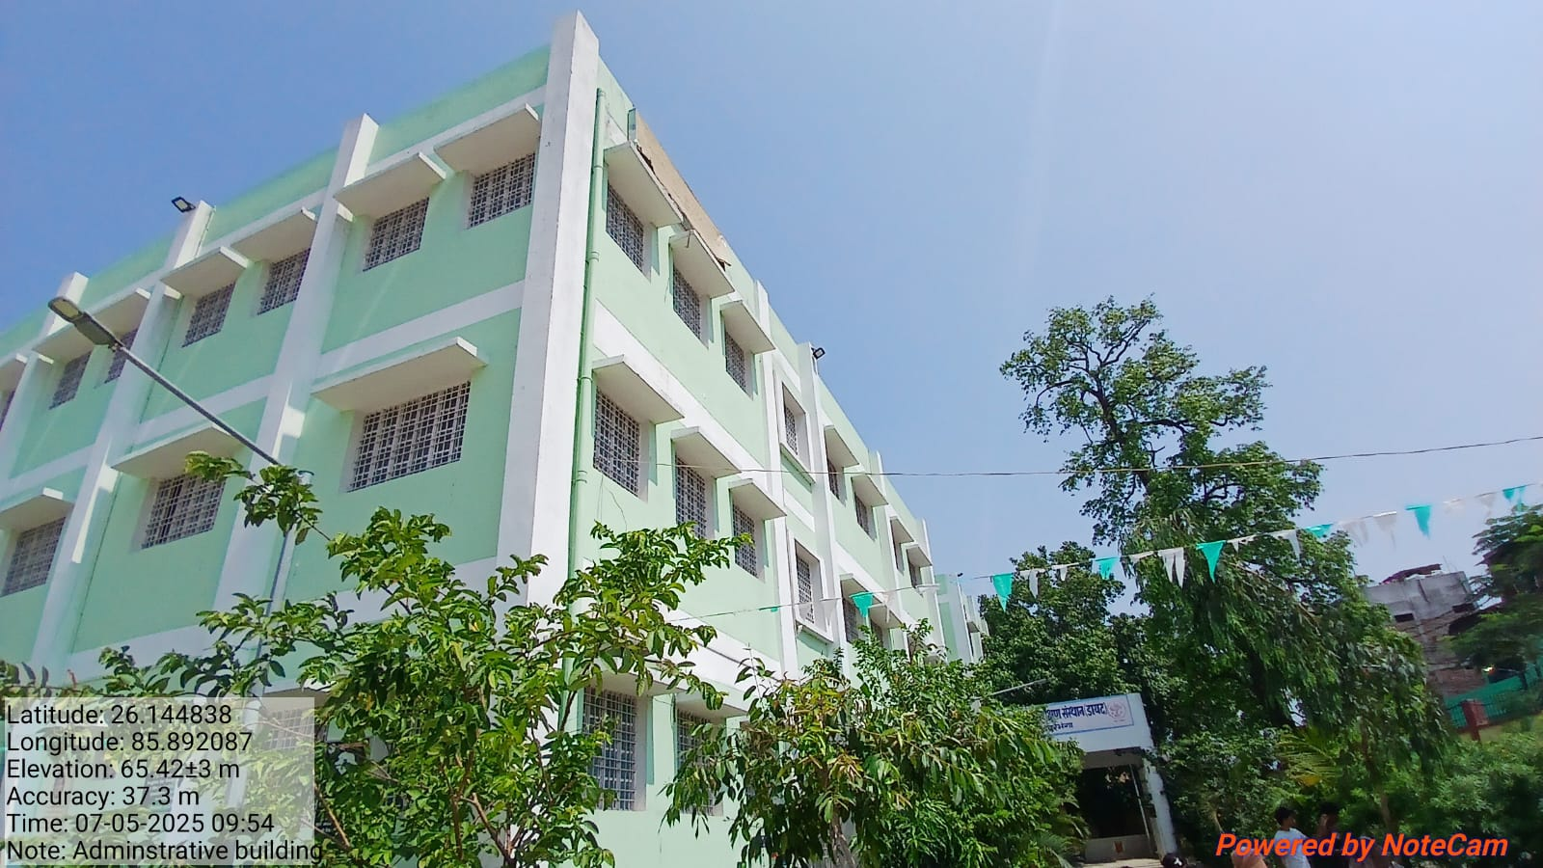
ADMINISTRATIVE BUILDING

Slide 3
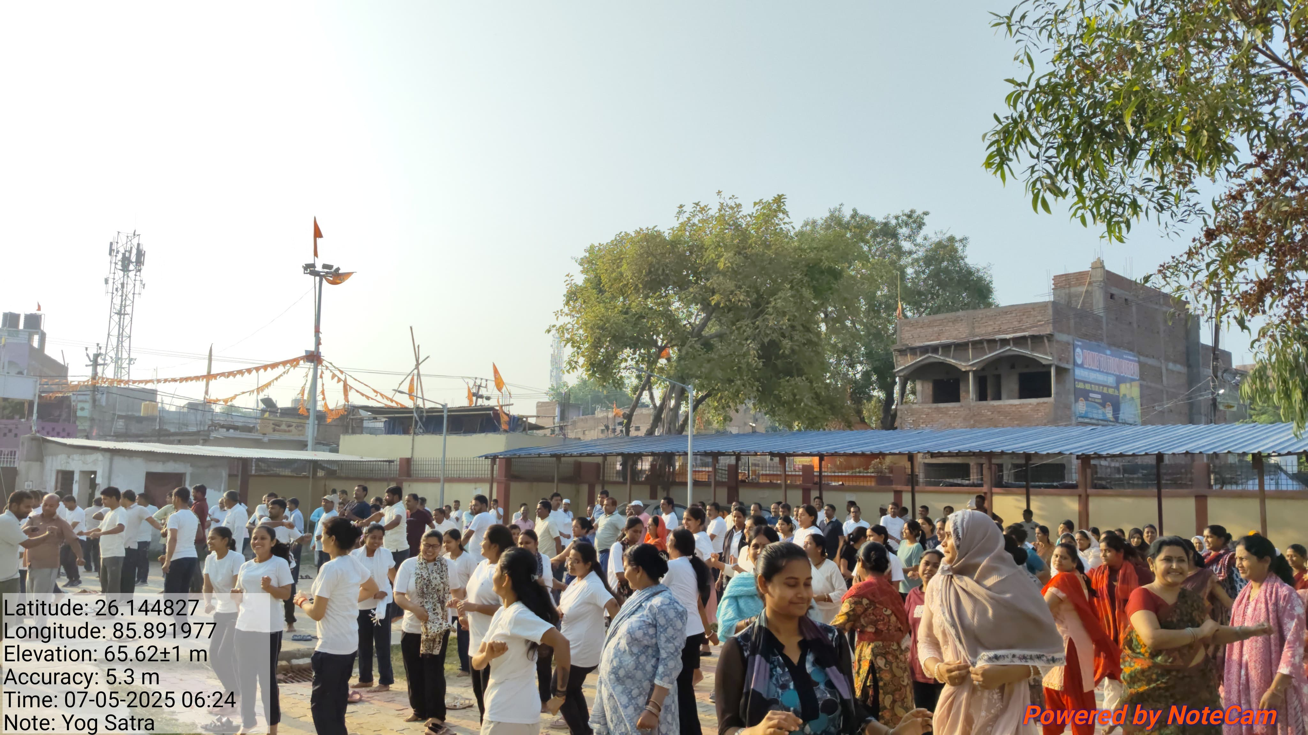
PT YOGA

Slide 4
BASIC REPORT
DISTRICT INSTITUTE OF EDUCATION & TRAINING (DIET) QUILAGHAT DARBHANGA
In Service Teachers Training (1-5) (FROM 05-05-2025 TO 10-05-2025)
1 .BASIC REPORT
A. DISTRICTWISE REPORT
 | SERIAL NO. | DISTRICT | BLOCK | N0. OF REQUISITION | NO. OF TEACHER REPORTED | NO. OF TEACHER ABSENT | NO OF BATCH | REGISTRATION STATUS | TRAINEES REPORTED AFTER 09:00 AM | ACTION TAKEN
 | 1 | Darbhanga | ALINAGAR, KUSHESWAR ASTHAN WEST | 260 | 238 | 22 | 4 | 100% | 0 | 0
B BLOCK WISE REPORT
 | SERIAL NO. |  | BLOCK | N0. OF REQUISITION | NO. OF TEACHER REPORTED | NO. OF TEACHER ABSENT | NO OF BATCH | REGISTRATION STATUS | TRAINEES REPORTED AFTER 09:00 AM | ACTION TAKEN
 |  | Darbhanga | ALINAGAR | 67 | 63 | 4 | 4
 | 1 |  | KUSHESWAR ASTHAN WEST | 193 | 175 | 18 |  | 100% | 0 | 0
 | TOTAL |  |  | 260 | 238 | 22

Slide 5
BASIC REPORT
C. BATCH WISE REPORT
BATCH NO | BLOCK | ALLOTED | N0. OF REGISTERED | NO. OF TEACHER ABSENT
1 | ALINAGAR, KUSHESWAR ASTHAN WEST | 70 | 66 | 4
2 | ALINAGAR, KUSHESWAR ASTHAN WEST | 70 | 63 | 7
3 | ALINAGAR, KUSHESWAR ASTHAN WEST | 55 | 50 | 5
4 | ALINAGAR, KUSHESWAR ASTHAN WEST | 65 | 59 | 6
 | TOTAL | 260 | 238 | 22
 | 2. YOGA/PT ATTENDENCE
 | NO OF TRAINEES PRESENT | ABSENT | ACTION
 | 238 | 0 | 0

Slide 6
BASIC REPORT
DISTRICT INSTITUTE OF EDUCATION & TRAINING (DIET) QUILAGHAT DARBHANGA
Computer Teacher Training for Class (6-8) (FROM 05-05-2025 TO10-05-2025)
1 .BASIC REPORT
A. DISTRICTWISE REPORT
 | SERIAL NO. | DISTRICT | BLOCK | N0. OF REQUISITION | NO. OF TEACHER REPORTED | NO. OF TEACHER ABSENT | NO OF BATCH | REGISTRATION STATUS | TRAINEES REPORTED AFTER 09:00 AM | ACTION TAKEN
 | 1 | Darbhanga | BAHADURPUR | 40 | 24 | 16 | 1 | 100% | 0 | 0
B BLOCK WISE REPORT
 | SERIAL NO. |  | BLOCK | N0. OF REQUISITION | NO. OF TEACHER REPORTED | NO. OF TEACHER ABSENT | NO OF BATCH | REGISTRATION STATUS | TRAINEES REPORTED AFTER 09:00 AM | ACTION TAKEN
 | 1 | Darbhanga | BAHADURPUR | 40 | 24 | 16 | 1 | 100% | 0 | 0
 | TOTAL |  |  | 40 | 24 | 16

Slide 7
BASIC REPORT
C. BATCH WISE REPORT
BATCH NO | BLOCK | ALLOTED | N0. OF REGISTERED | NO. OF TEACHER ABSENT
1 | BAHADURPUR | 40 | 24 | 16
 | TOTAL | 40 | 24 | 16
 | 2. YOGA/PT ATTENDENCE
 | NO OF TRAINEES PRESENT | ABSENT | ACTION
 | 24 | 0 | 0

Slide 8
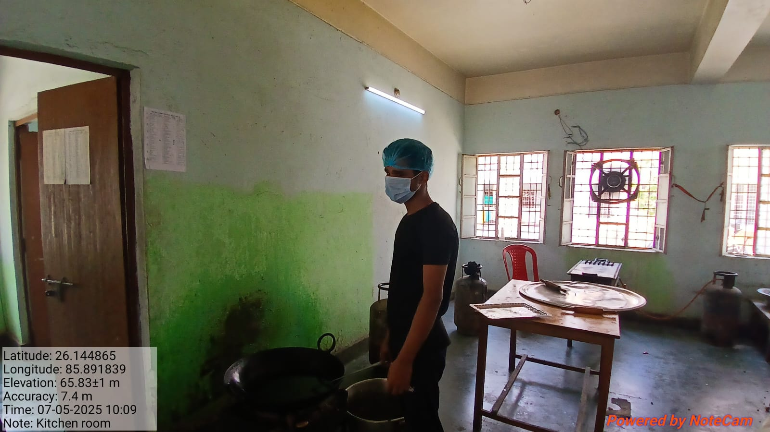
KITCHEN

Slide 9
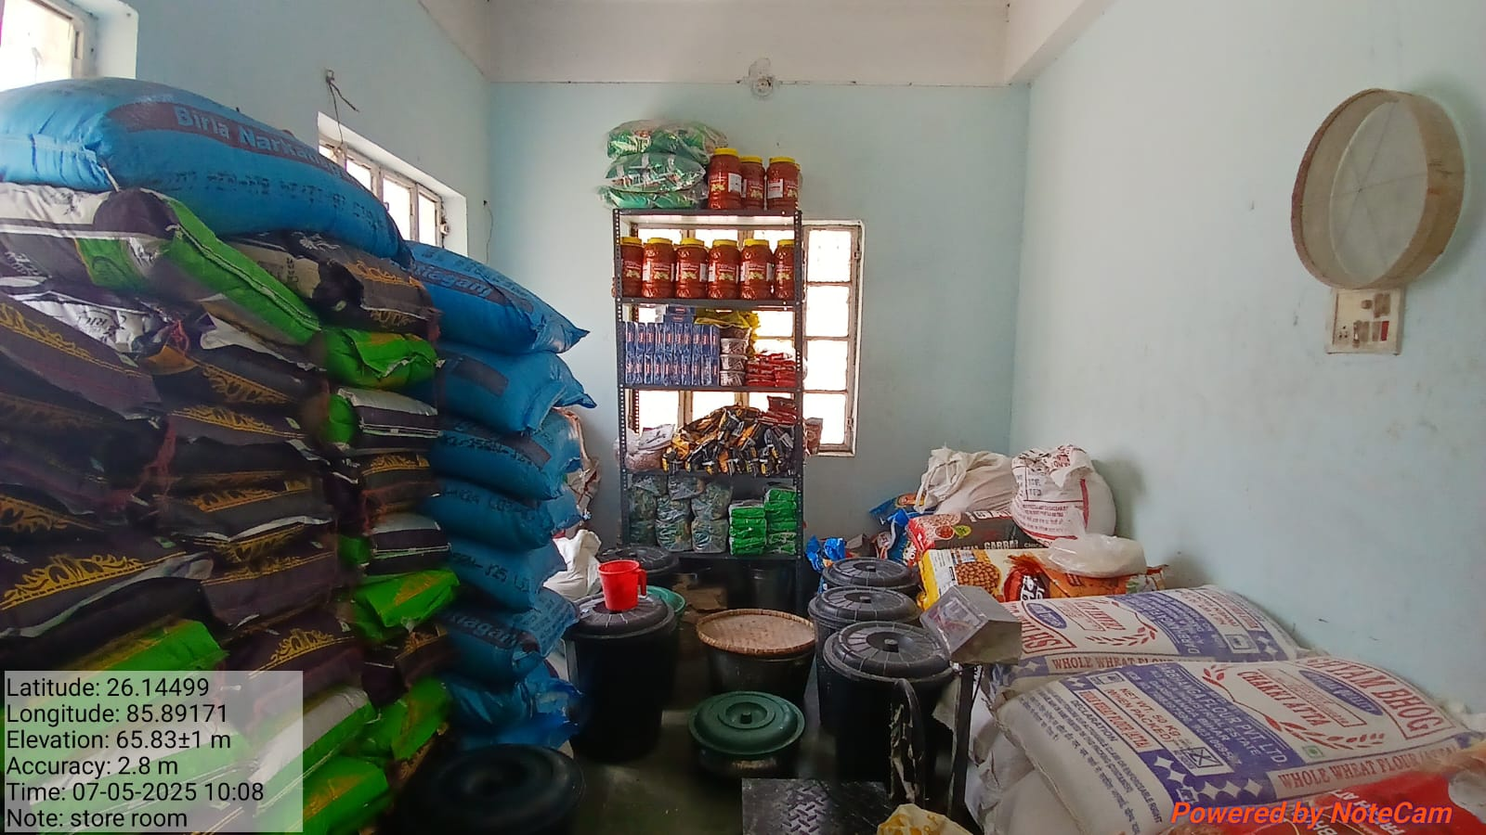
STORE

Slide 10
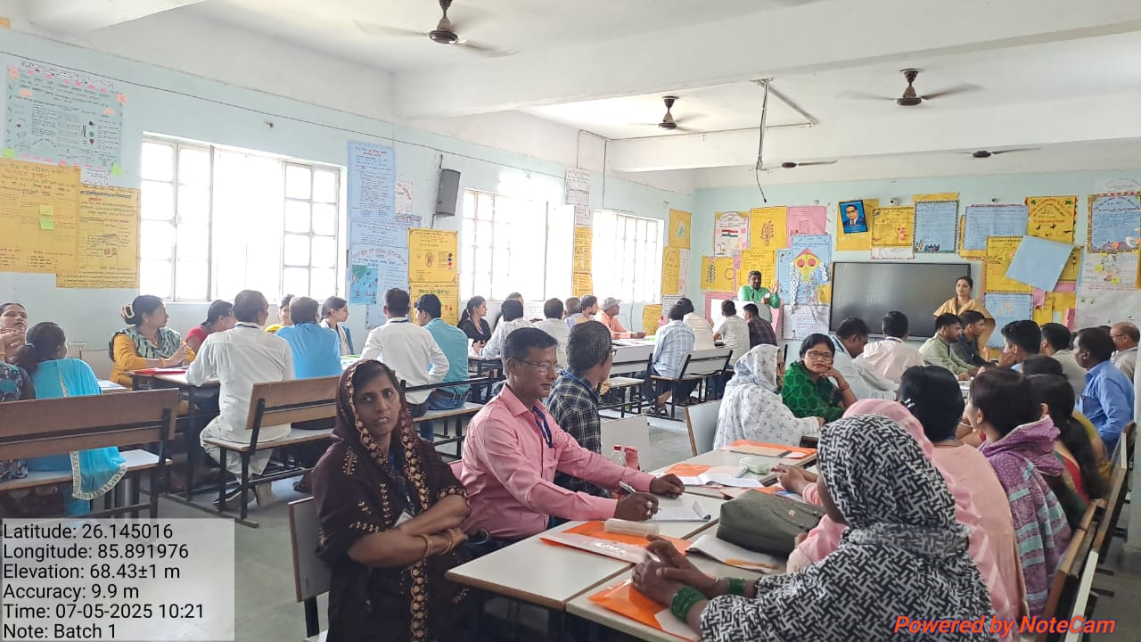
BATCH-1

Slide 11
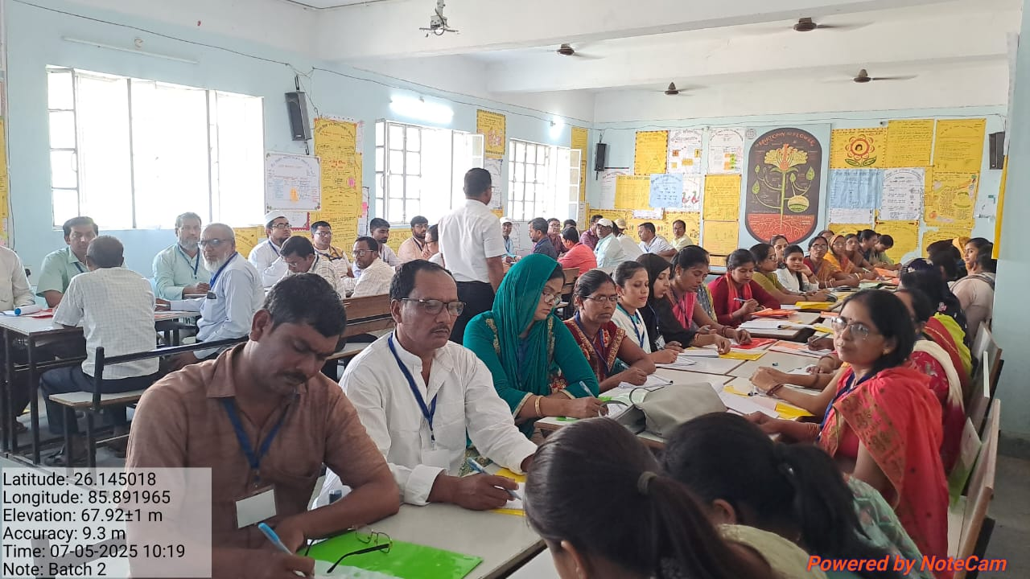
BATCH-2

Slide 12
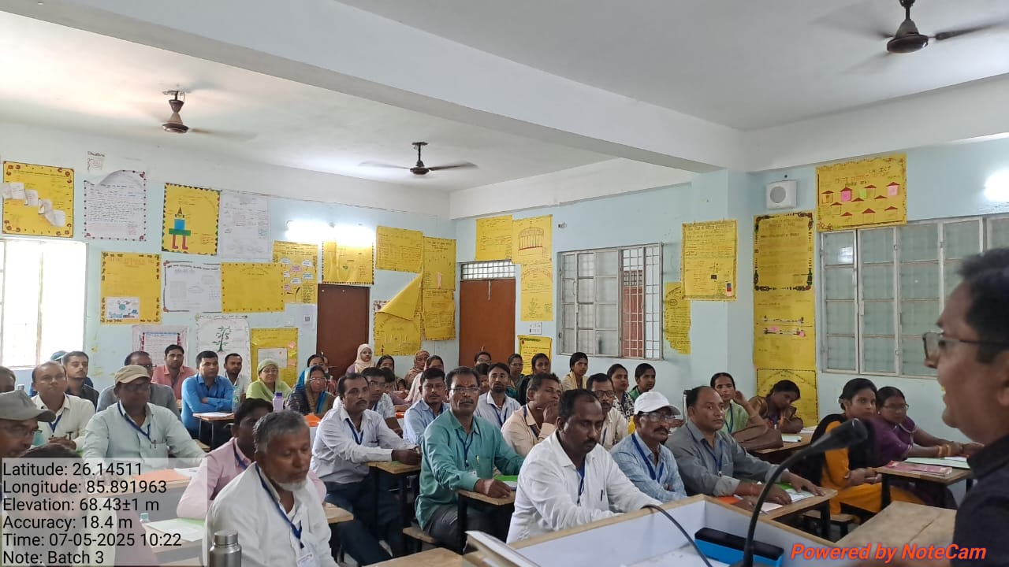
BATCH-3

Slide 13
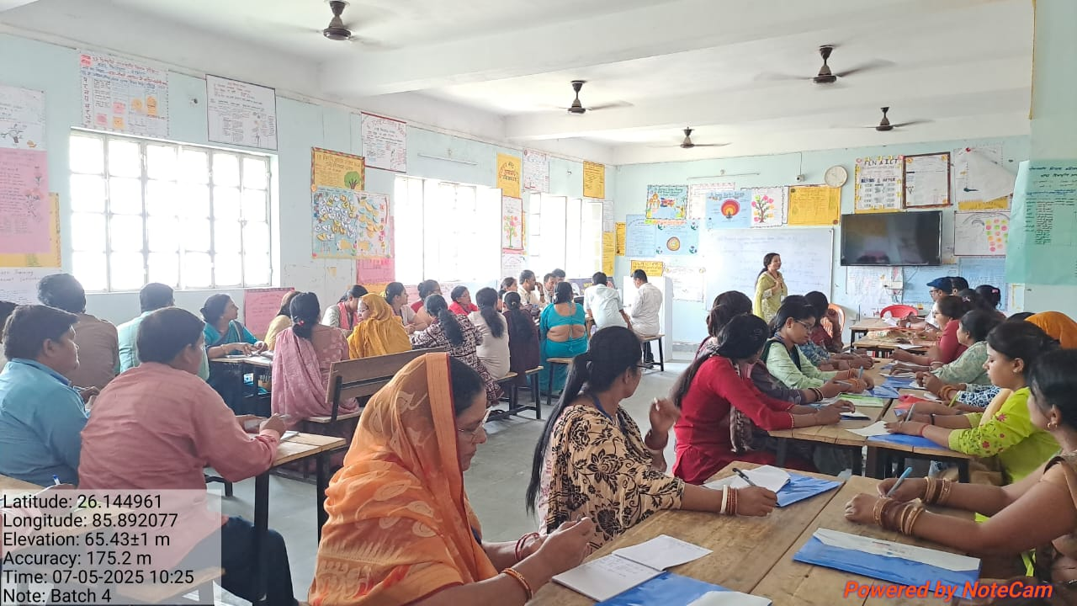
BATCH-4

Slide 14
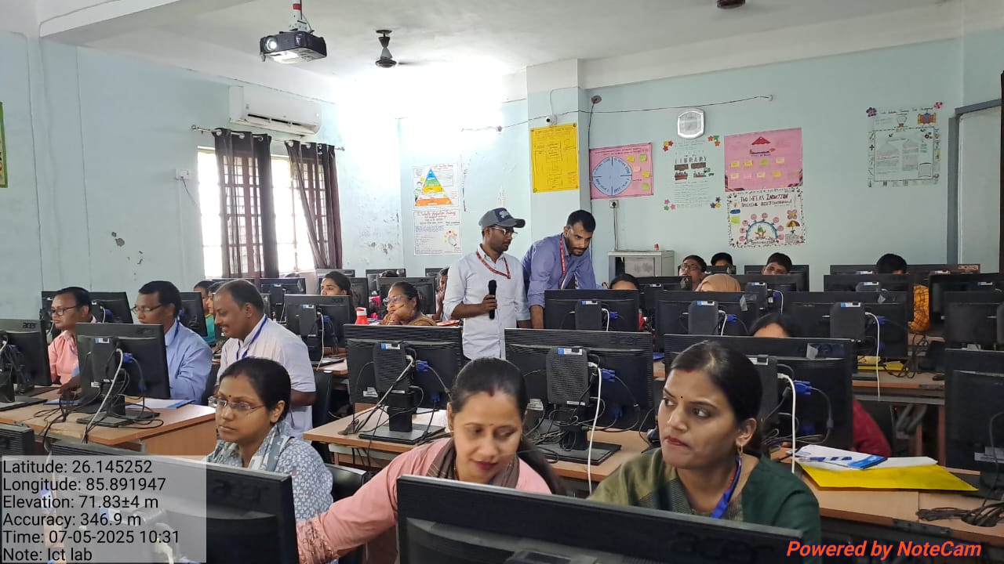
BATCH-5 (ICT LAB)

Slide 15
BOYS HOSTEL DINING

Slide 16
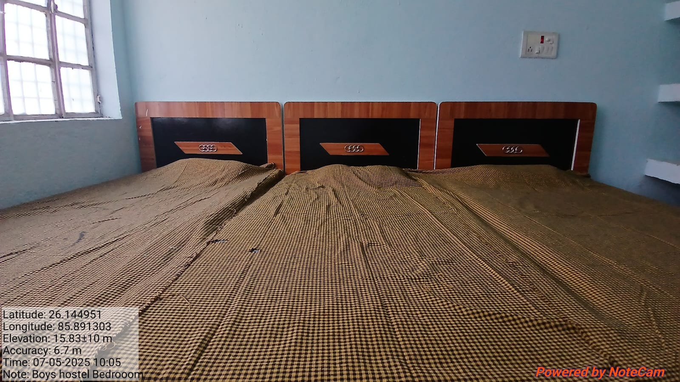
BOYS HOSTEL BED

Slide 17
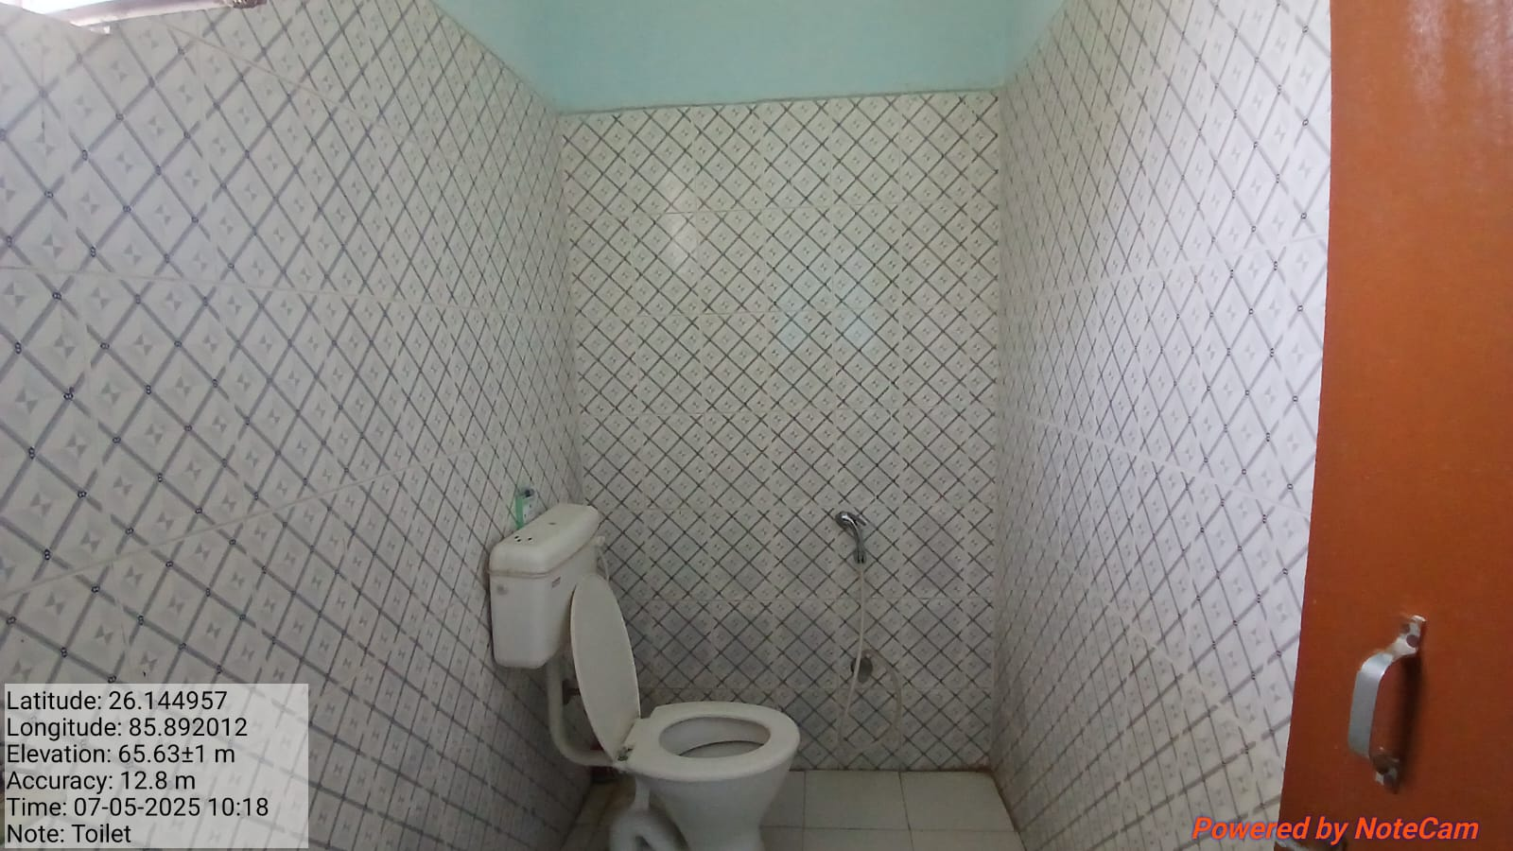
BOYS HOSTEL TOILET

Slide 18
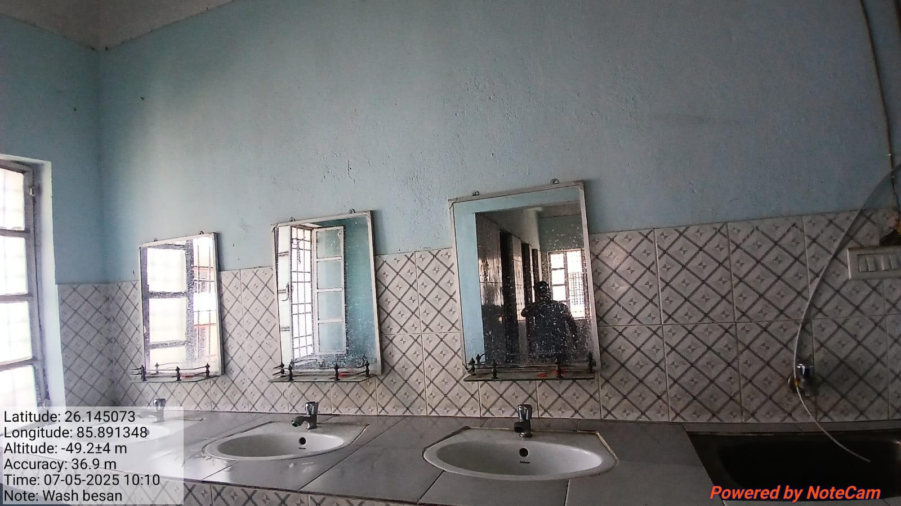
BOYS HOSTEL WASHBASIN

Slide 19
GIRLS HOSTEL DINING

Slide 20
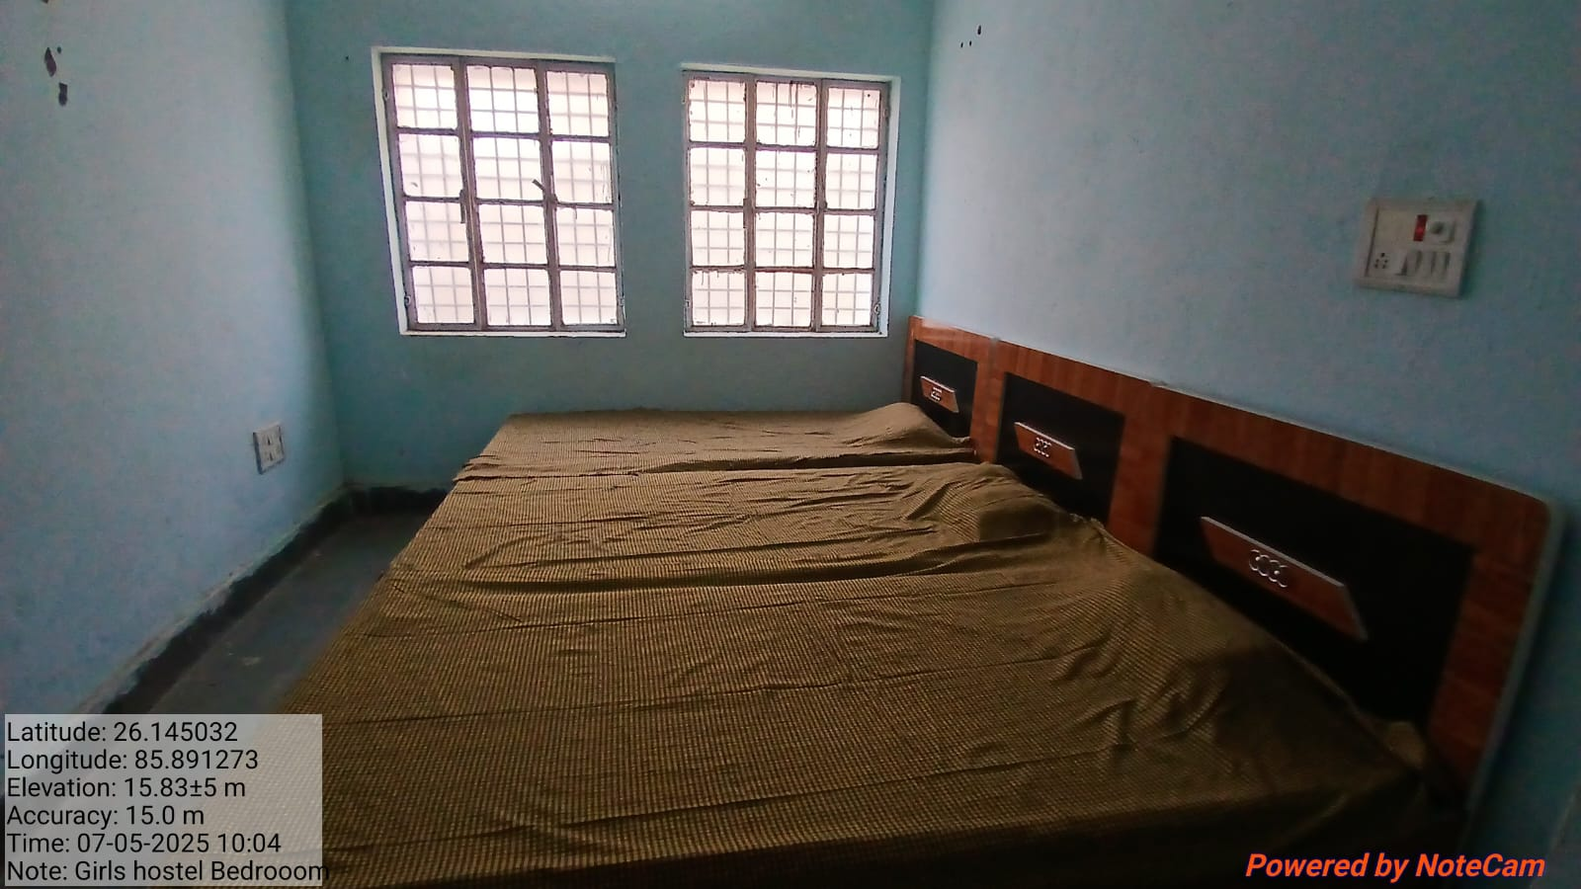
GIRLS HOSTEL BED

Slide 21
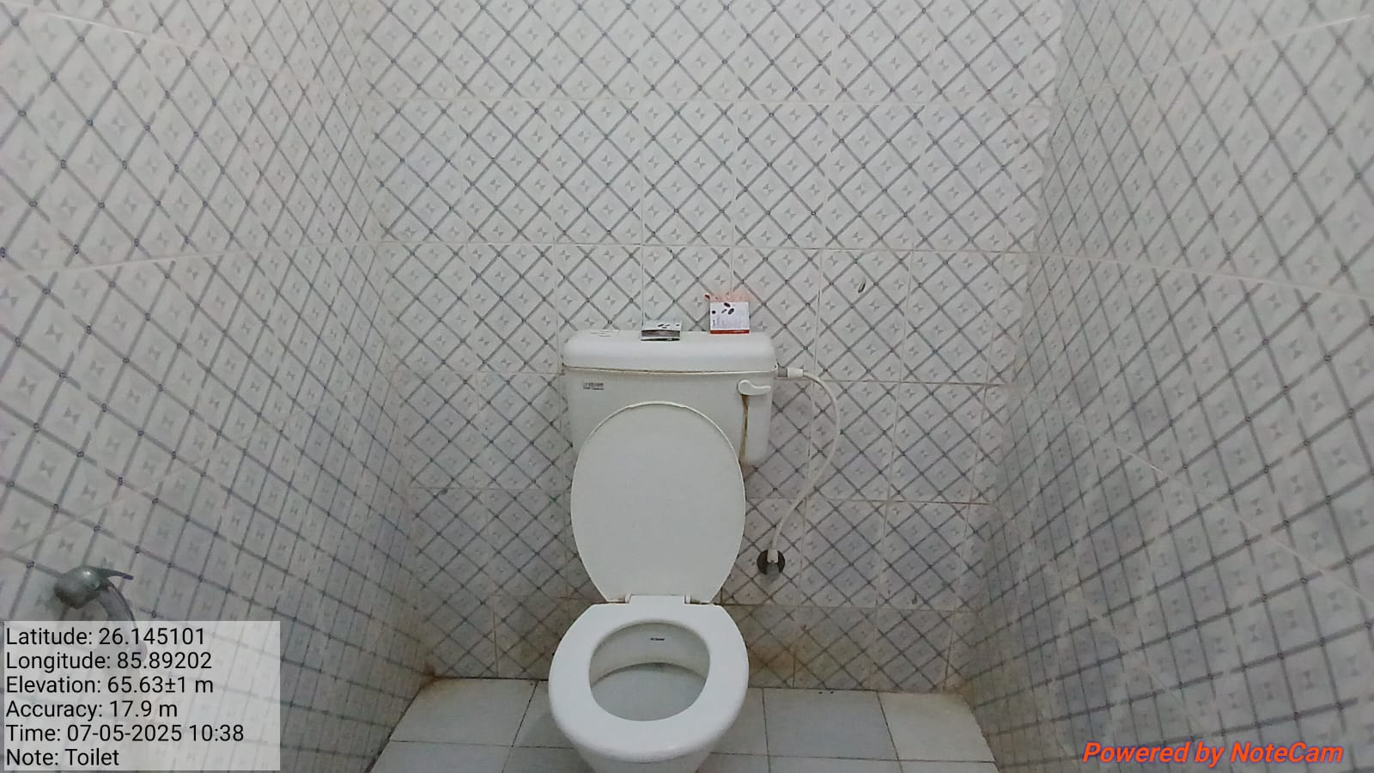
GIRLS HOSTEL TOILET

Slide 22
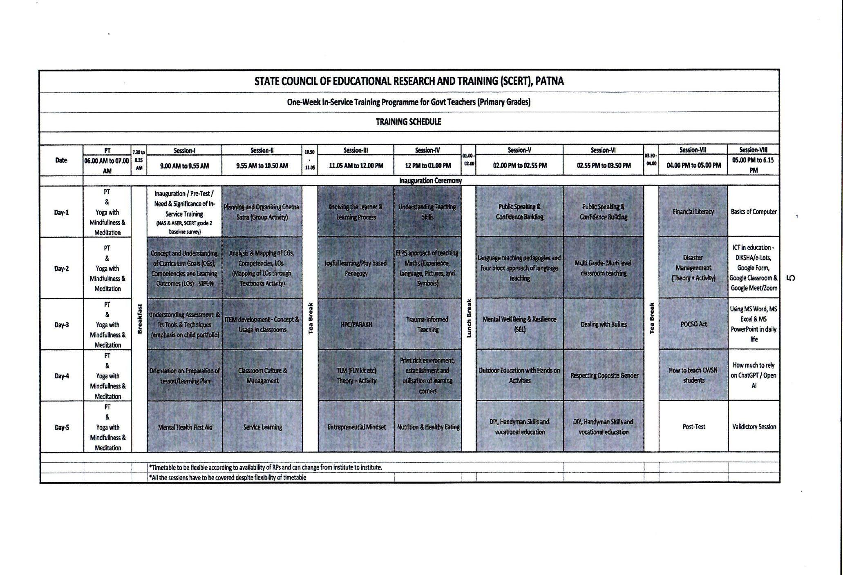
ROUTINE

Slide 23
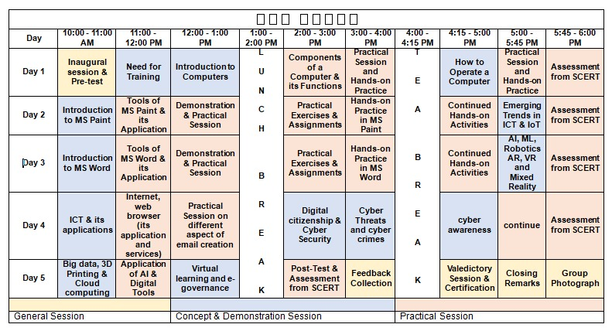
COMPUTER ROUTINE

Slide 24
(BATCH 1-5)
 | BATCH | NAME | MOBILE NO
1 | BATCH-1 | SRIMATI PREMLATA KUMARI | 9431253078
 |  | SIMATI KANCHAN KUMARI | 9334640508
2 | BATCH-2 | DR. UMESH KUMAR RAJESH | 8340508688
 |  | DR. BIRENDRA KUMAR CHATURWEDI | 9006830688
3 | BATCH-3 | DR. PRADIP KUMAR PRASAD | 9334973981
 |  | DR. SHABBIR HUSSAIN | 9470437301
4 | BATCH-4 | DR. ROMILA TETE | 9934258548
 |  | DR. ABHAY CHANDRA JHA | 9470049675
5 | BATCH-5 | MD. KALMULLAH | 9771114636
 |  | PRAMOD KUMAR PRAJAPATTI | 9532334534
 |  | SRI SATYJIT RAY | 7766008209

Slide 25
100% on Boarding Completed

Slide 26
THANK YOU

