Slide 1
DISTRICT INSTITUTE OF EDUCATION AND TRAINING (DIET), QUILAGHAT DARBHANGA

Slide 2
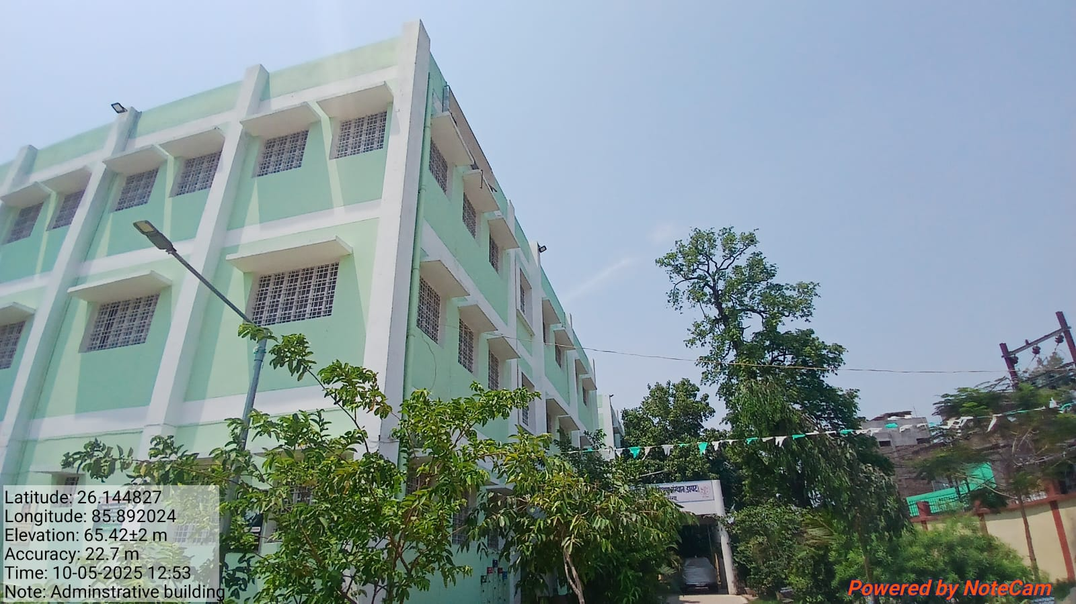
ADMINISTRATIVE BUILDING

Slide 3
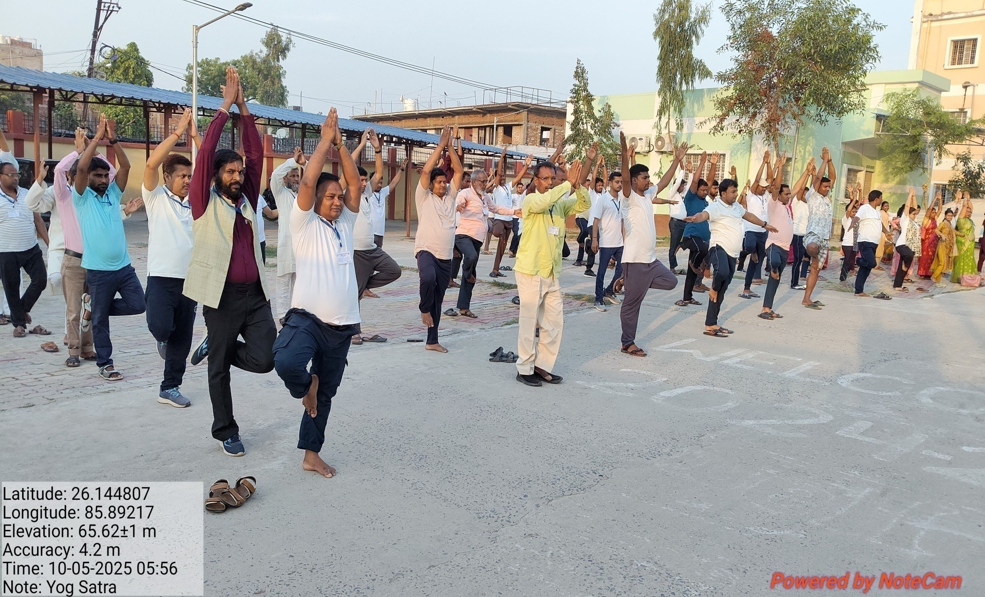
PT YOGA

Slide 4
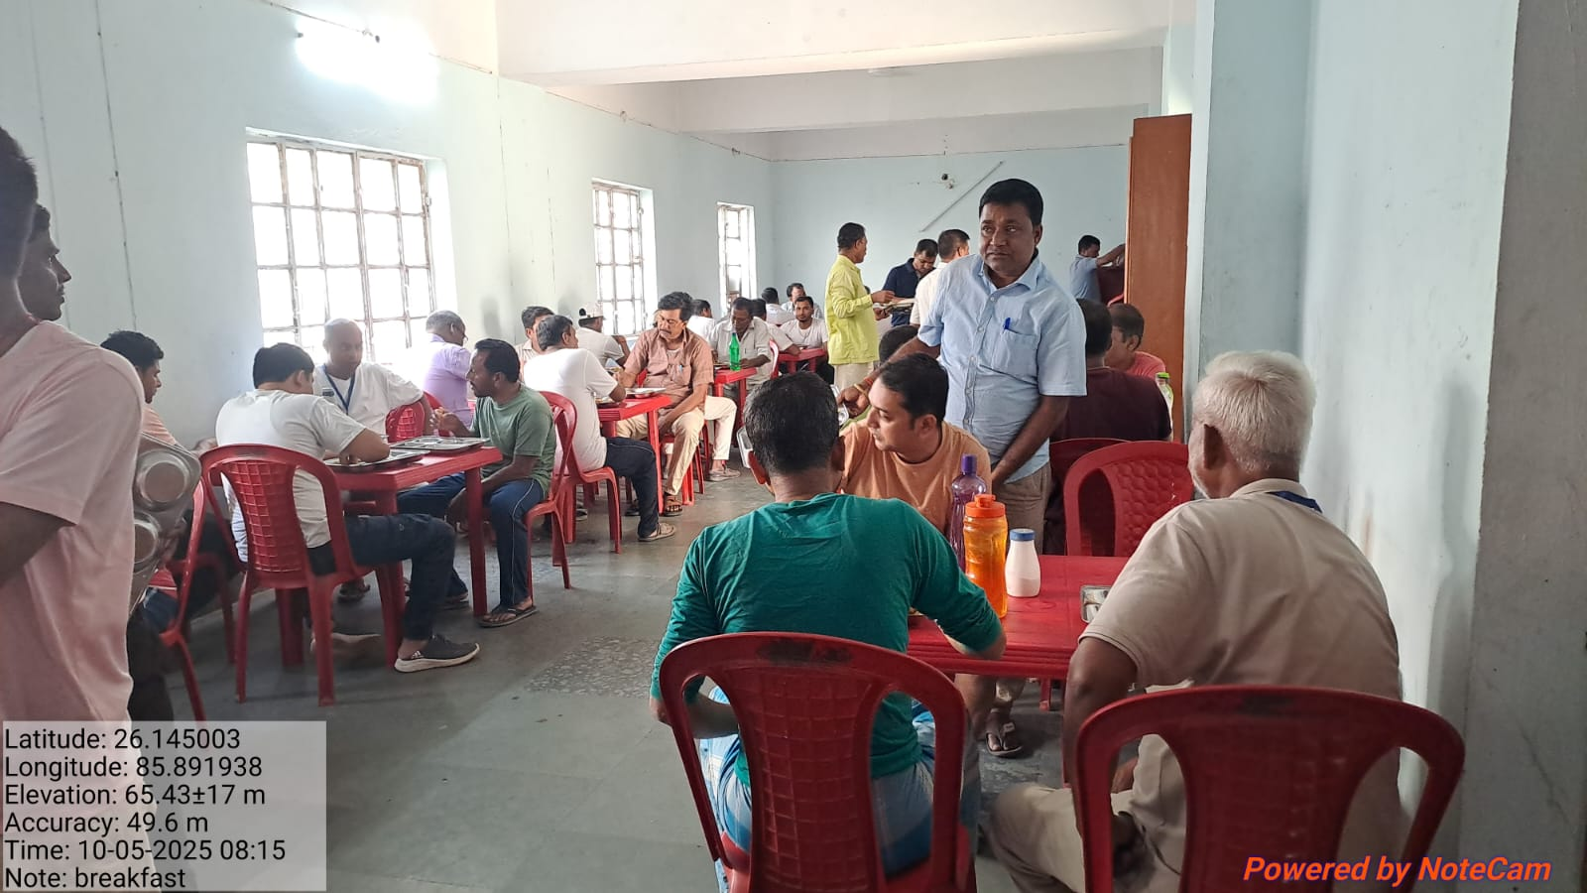
BREAKFAST

Slide 5
BASIC REPORT
DISTRICT INSTITUTE OF EDUCATION & TRAINING (DIET) QUILAGHAT DARBHANGA
In Service Teachers Training (1-5) (FROM 05-05-2025 TO 10-05-2025)
1 .BASIC REPORT
A. DISTRICTWISE REPORT
 | SERIAL NO. | DISTRICT | BLOCK | N0. OF REQUISITION | NO. OF TEACHER REPORTED | NO. OF TEACHER ABSENT | NO OF BATCH | REGISTRATION STATUS | TRAINEES REPORTED AFTER 09:00 AM | ACTION TAKEN
 | 1 | Darbhanga | ALINAGAR, KUSHESWAR ASTHAN WEST | 260 | 238 | 22 | 4 | 100% | 0 | 0
B BLOCK WISE REPORT
 | SERIAL NO. |  | BLOCK | N0. OF REQUISITION | NO. OF TEACHER REPORTED | NO. OF TEACHER ABSENT | NO OF BATCH | REGISTRATION STATUS | TRAINEES REPORTED AFTER 09:00 AM | ACTION TAKEN
 |  | Darbhanga | ALINAGAR | 67 | 63 | 4 | 4
 | 1 |  | KUSHESWAR ASTHAN WEST | 193 | 175 | 18 |  | 100% | 0 | 0
 | TOTAL |  |  | 260 | 238 | 22

Slide 6
BASIC REPORT
C. BATCH WISE REPORT
BATCH NO | BLOCK | ALLOTED | N0. OF REGISTERED | NO. OF TEACHER ABSENT
1 | ALINAGAR, KUSHESWAR ASTHAN WEST | 70 | 66 | 4
2 | ALINAGAR, KUSHESWAR ASTHAN WEST | 70 | 63 | 7
3 | ALINAGAR, KUSHESWAR ASTHAN WEST | 55 | 50 | 5
4 | ALINAGAR, KUSHESWAR ASTHAN WEST | 65 | 59 | 6
 | TOTAL | 260 | 238 | 22
 | 2. YOGA/PT ATTENDENCE
 | NO OF TRAINEES PRESENT | ABSENT | ACTION
 | 238 | 0 | 0

Slide 7
BASIC REPORT
DISTRICT INSTITUTE OF EDUCATION & TRAINING (DIET) QUILAGHAT DARBHANGA
Computer Teacher Training for Class (6-8) (FROM 05-05-2025 TO10-05-2025)
1 .BASIC REPORT
A. DISTRICTWISE REPORT
 | SERIAL NO. | DISTRICT | BLOCK | N0. OF REQUISITION | NO. OF TEACHER REPORTED | NO. OF TEACHER ABSENT | NO OF BATCH | REGISTRATION STATUS | TRAINEES REPORTED AFTER 09:00 AM | ACTION TAKEN
 | 1 | Darbhanga | BAHADURPUR | 40 | 24 | 16 | 1 | 100% | 0 | 0
B BLOCK WISE REPORT
 | SERIAL NO. |  | BLOCK | N0. OF REQUISITION | NO. OF TEACHER REPORTED | NO. OF TEACHER ABSENT | NO OF BATCH | REGISTRATION STATUS | TRAINEES REPORTED AFTER 09:00 AM | ACTION TAKEN
 | 1 | Darbhanga | BAHADURPUR | 40 | 24 | 16 | 1 | 100% | 0 | 0
 | TOTAL |  |  | 40 | 24 | 16

Slide 8
BASIC REPORT
C. BATCH WISE REPORT
BATCH NO | BLOCK | ALLOTED | N0. OF REGISTERED | NO. OF TEACHER ABSENT
1 | BAHADURPUR | 40 | 24 | 16
 | TOTAL | 40 | 24 | 16
 | 2. YOGA/PT ATTENDENCE
 | NO OF TRAINEES PRESENT | ABSENT | ACTION
 | 24 | 0 | 0

Slide 9
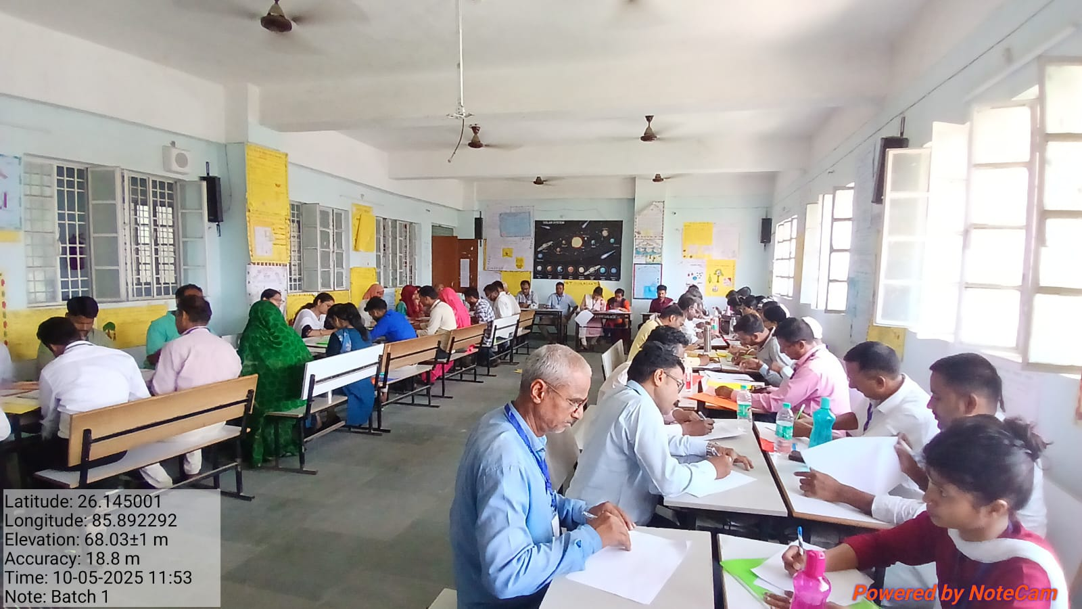
(BATCH-1)

Slide 10
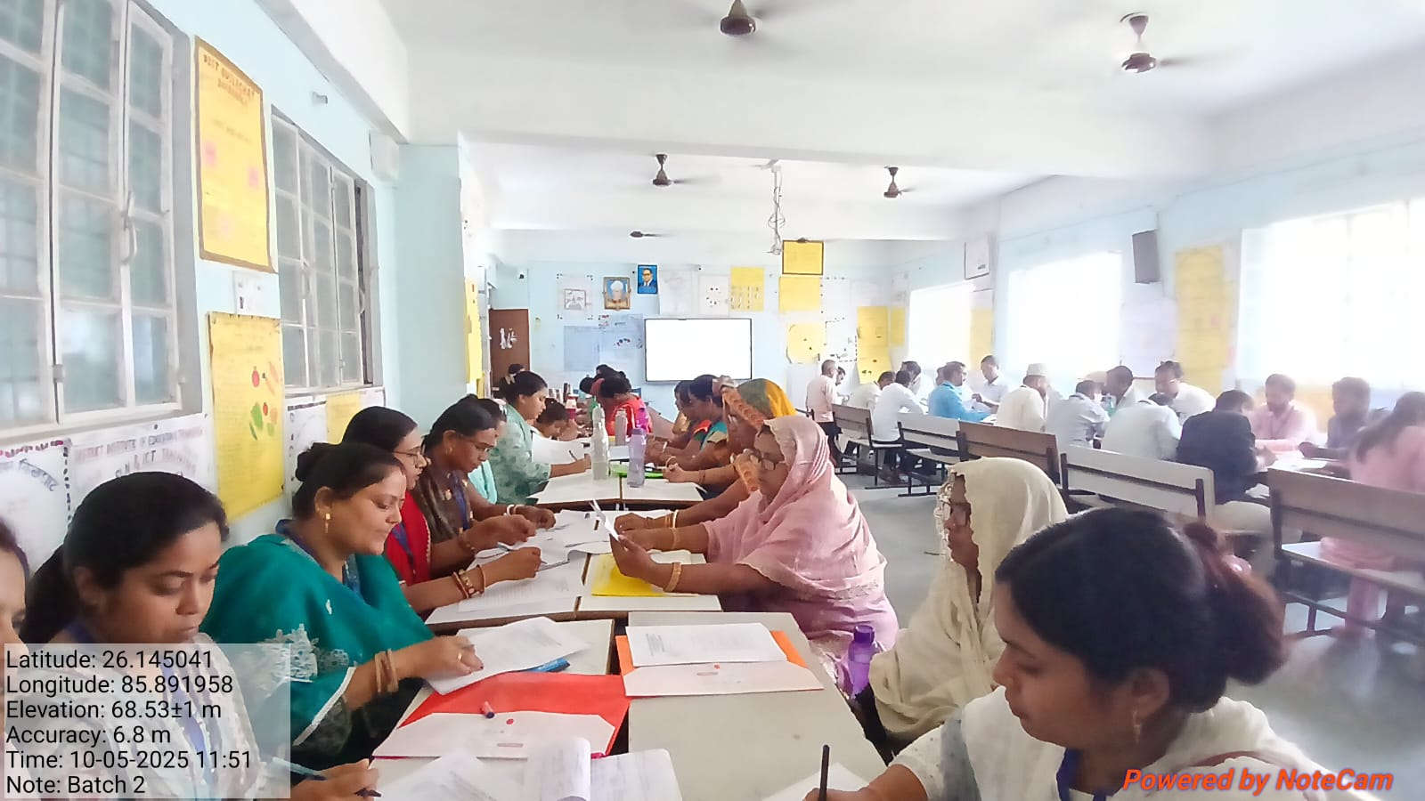
(BATCH-2)

Slide 11
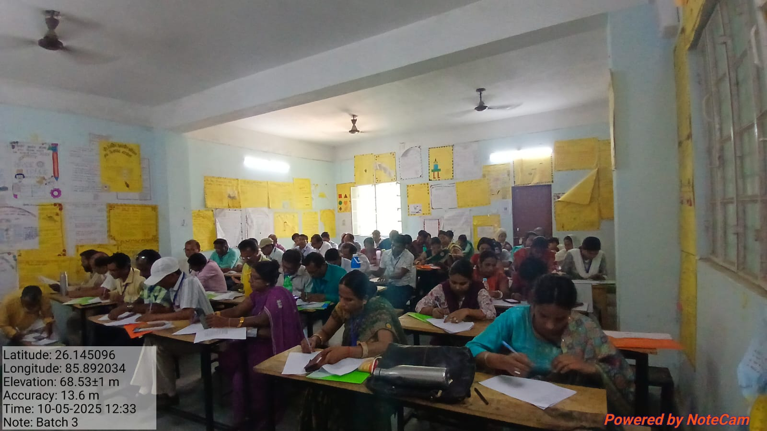
(BATCH-3)

Slide 12
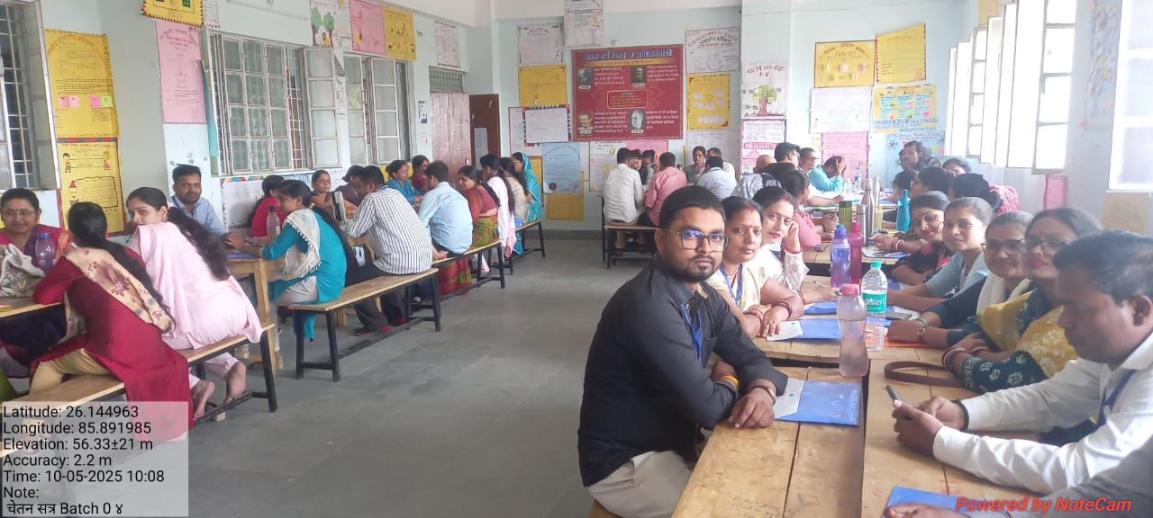
(BATCH-4)

Slide 13
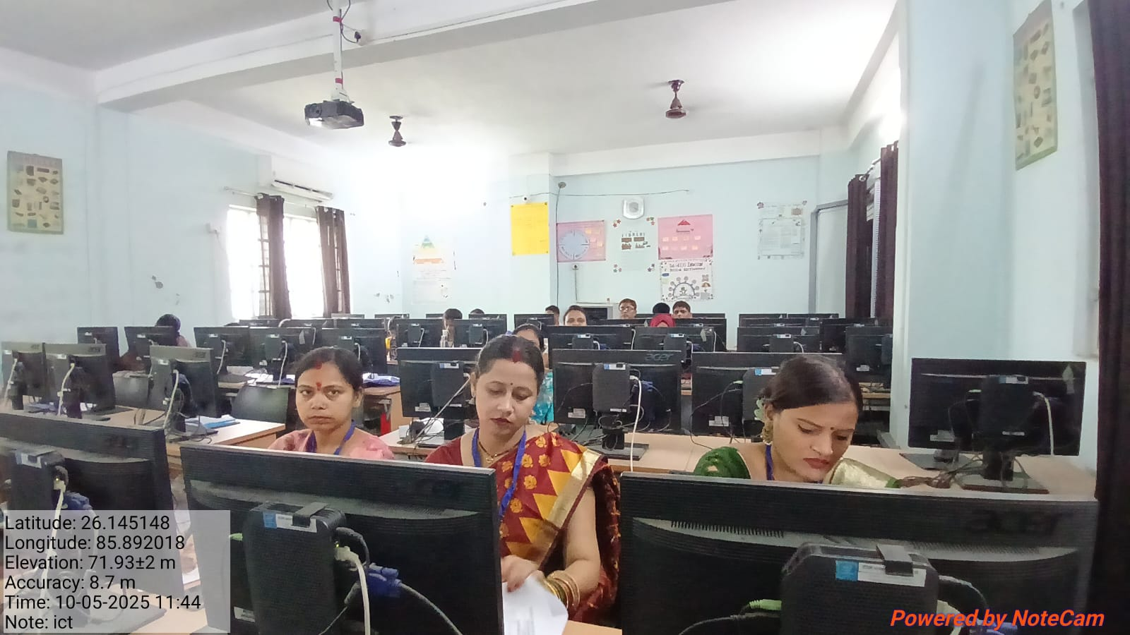
(BATCH-5 ICT LAB)

Slide 14
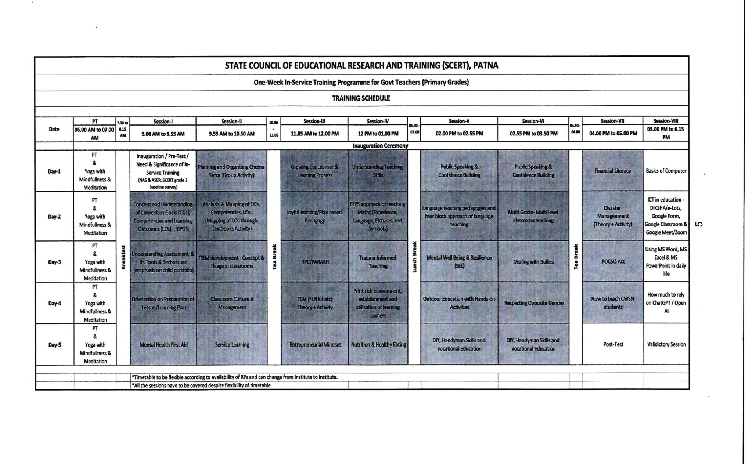
(ROUTINE)

Slide 15
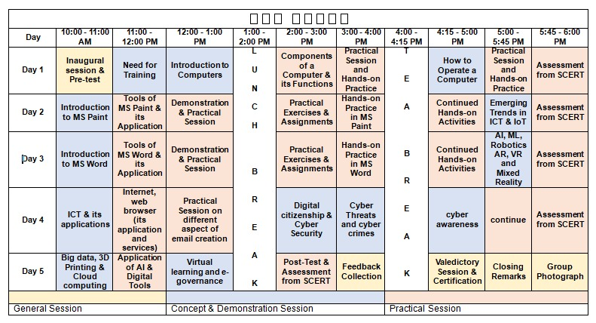
( COMPUTER ROUTINE)

Slide 16
(BATCH-1-5)
 | BATCH | NAME | MOBILE NO
1 | BATCH-1 | SRIMATI PREMLATA KUMARI | 9431253078
 |  | SIMATI KANCHAN KUMARI | 9334640508
2 | BATCH-2 | DR. UMESH KUMAR RAJESH | 8340508688
 |  | DR. BIRENDRA KUMAR CHATURWEDI | 9006830688
3 | BATCH-3 | DR. PRADIP KUMAR PRASAD | 9334973981
 |  | DR. SHABBIR HUSSAIN | 9470437301
4 | BATCH-4 | DR. ROMILA TETE | 9934258548
 |  | DR. ABHAY CHANDRA JHA | 9470049675
5 | BATCH-5 | MD. KALMULLAH | 9771114636
 |  | PRAMOD KUMAR PRAJAPATTI | 9532334534
 |  | SRI SATYJIT RAY | 7766008209

Slide 17
THANK YOU

