Slide 1
DISTRICT INSTITUTE OF EDUCATION AND TRAINING (DIET), QUILAGHAT DARBHANGA

Slide 2
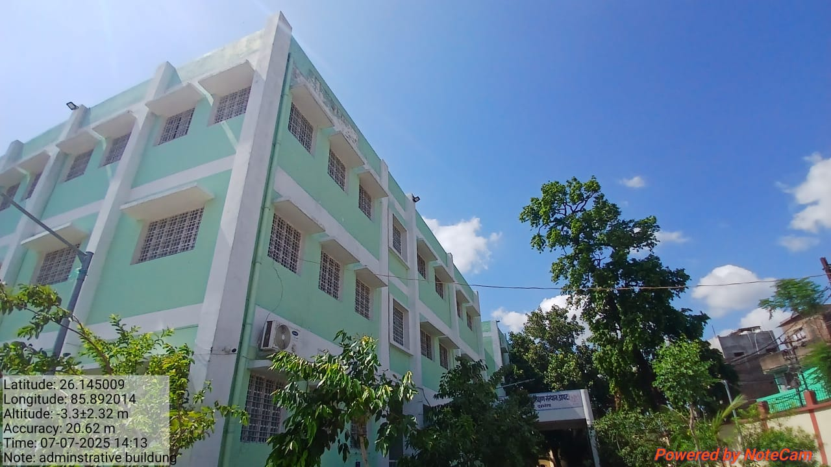
ADMINISTRATIVE BUILDING

Slide 3
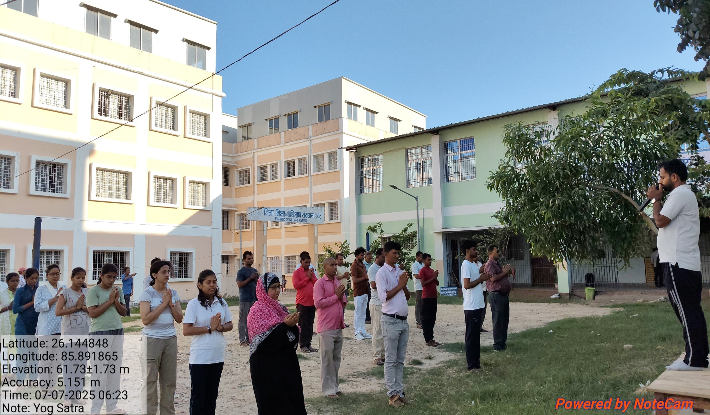
YOGA

Slide 4
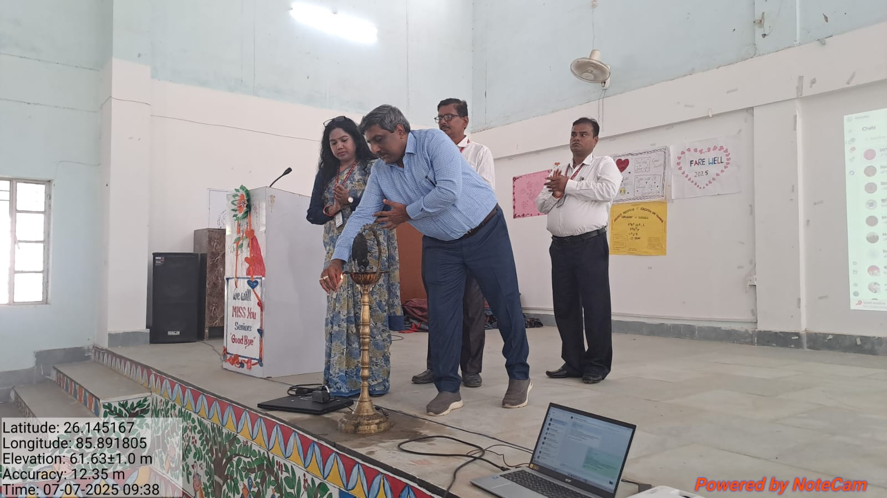
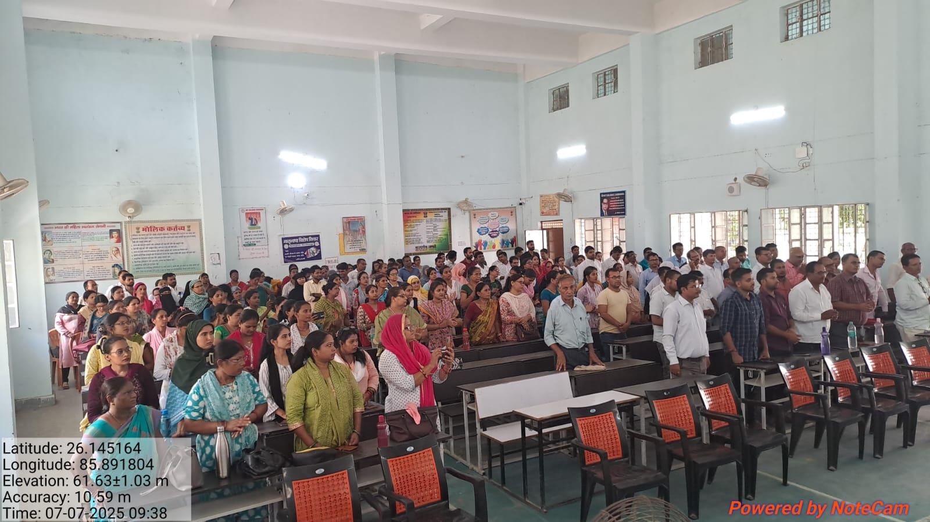
INAUGURATION

Slide 5
BASIC REPORT
DISTRICT INSTITUTE OF EDUCATION & TRAINING (DIET) QUILAGHAT DARBHANGA
In Service Teachers Training (3-5) (FROM 07-7-2025 TO 11-07-2025)
1 .BASIC REPORT
A. DISTRICTWISE REPORT
 | SERIAL NO. | DISTRICT | BLOCK | N0. OF REQUISITION | NO. OF TEACHER REPORTED | NO. OF TEACHER ABSENT | NO OF BATCH | REGISTRATION STATUS | TRAINEES REPORTED AFTER 09:00 AM | ACTION TAKEN
 | 1 | Darbhanga | SINGHWARA | 283 | 234 | 49 | 4 | 100% | 0 | 0
B BLOCK WISE REPORT
 | SERIAL NO. |  | BLOCK | N0. OF REQUISITION | NO. OF TEACHER REPORTED | NO. OF TEACHER ABSENT | NO OF BATCH | REGISTRATION STATUS | TRAINEES REPORTED AFTER 09:00 AM | ACTION TAKEN
 | 1 | Darbhanga | SINGHWARA | 283 | 234 | 49 | 4 | 100% | 0 | 0
 | TOTAL |  |  | 283 | 234 | 49 | 4 | 100% | 0 | 0

Slide 6
BASIC REPORT
C. BATCH WISE REPORT
BATCH NO | BLOCK | ALLOTED | N0. OF REGISTERED | NO. OF TEACHER ABSENT
1 | SINGHWARA | 75 | 57 | 18
2 | SINGHWARA | 75 | 62 | 13
3 | SINGHWARA | 60 | 51 | 9
4 | SINGHWARA | 73 | 64 | 9
 | TOTAL | 283 | 234 | 49
 | 2. YOGA/PT ATTENDENCE
 | NO OF TRAINEES PRESENT | ABSENT | ACTION
 | 234 | 49 | 0

Slide 7
BASIC REPORT
DISTRICT INSTITUTE OF EDUCATION & TRAINING (DIET) QUILAGHAT DARBHANGA
Computer Teacher Training for Class ( 6-8) (FROM 07-07-2025 TO 11-07-2025)
1 .BASIC REPORT
A. DISTRICTWISE REPORT
 | SERIAL NO. | DISTRICT | BLOCK | N0. OF REQUISITION | NO. OF TEACHER REPORTED | NO. OF TEACHER ABSENT | NO OF BATCH | REGISTRATION STATUS | TRAINEES REPORTED AFTER 09:00 AM | ACTION TAKEN
 | 1 | Darbhanga | BAHERI | 40 | 21 | 19 | 1 | 100% | 0 | 0
B BLOCK WISE REPORT
 | SERIAL NO. | DISTRICT | BLOCK | N0. OF REQUISITION | NO. OF TEACHER REPORTED | NO. OF TEACHER ABSENT | NO OF BATCH | REGISTRATION STATUS | TRAINEES REPORTED AFTER 09:00 AM | ACTION TAKEN
 | 1 | Darbhanga | BAHERI | 40 | 21 | 19 | 1 | 100% | 0 | 0
 | TOTAL |  |  | 40 | 21 | 19

Slide 8
BASIC REPORT
C. BATCH WISE REPORT
BATCH NO | BLOCK | ALLOTED | N0. OF REGISTERED | NO. OF TEACHER ABSENT
1 | BAHERI | 40 | 21 | 19
 | TOTAL | 40 | 21 | 19
 | 2. YOGA/PT ATTENDENCE
 | NO OF TRAINEES PRESENT | ABSENT | ACTION
 | 21 | 0 | 0

Slide 9
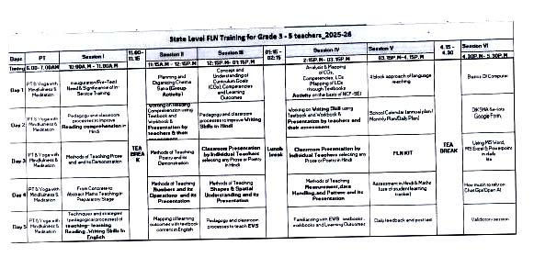
In Service Teachers Training 3-5 ROUTINE

Slide 10
COMPUTER ROUTINE

Slide 11
(BATCH-3 TO 5)
 | BATCH-1 | NAME | MOBILE NO
1 |  | DR. ROMILA TETE | 9934258548
 |  | DR. BIRENDRA KUMAR CHATURWEDI | 9006830688
2 | BATCH-2 | SRIMATI RASHMI JHA | 8294190257
 |  | DR. SHABBIR HUSSAIN | 9470437301
3 | BATCH-3 | SRIMATI KANCHAN KUMARI | 9334640508
 |  | SRI PANKAJ KUMAR | 8210319747
4 | BATCH-4 | SRI SANTOSH KUMAR | 9693247667
 |  | DR. UMESH KUMAR RAJESH | 8340508688
5 | BATCH-5 | MD. KALMULLAH | 9771114636
 |  | DR. PRINCE KUMAR | 8668897951

Slide 12
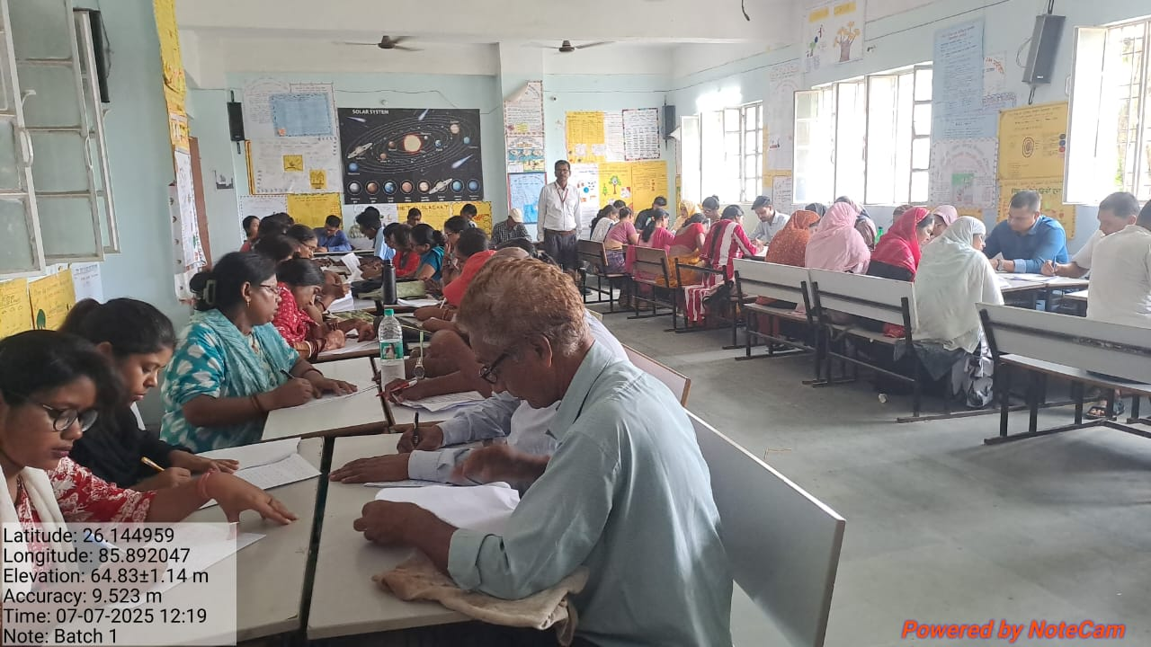
BATCH -1 (In Service Teachers Training 3-5)

Slide 13
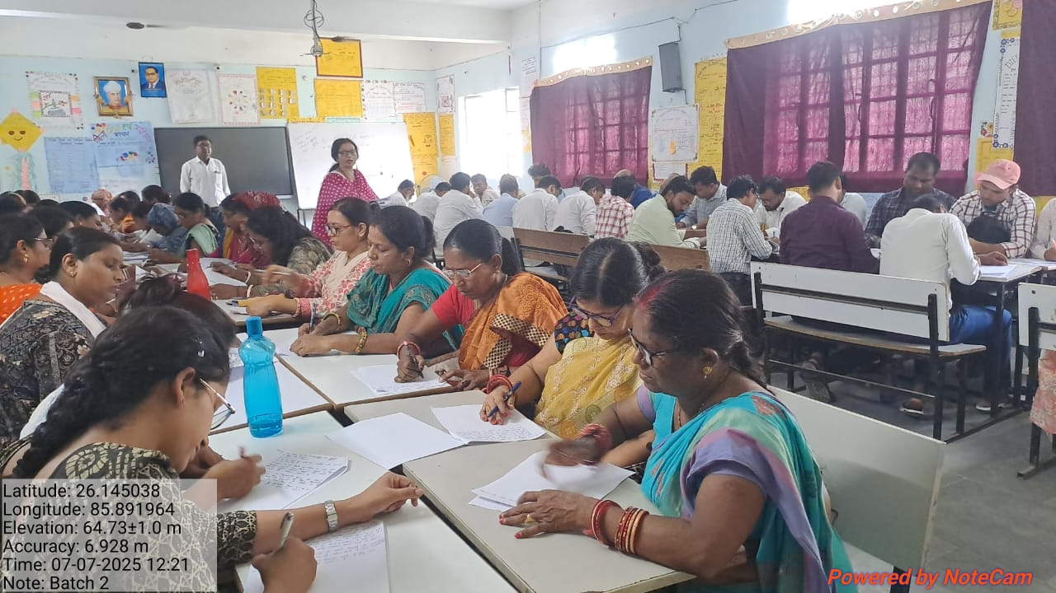
BATCH-2( In Service Teachers Training 3-5)

Slide 14
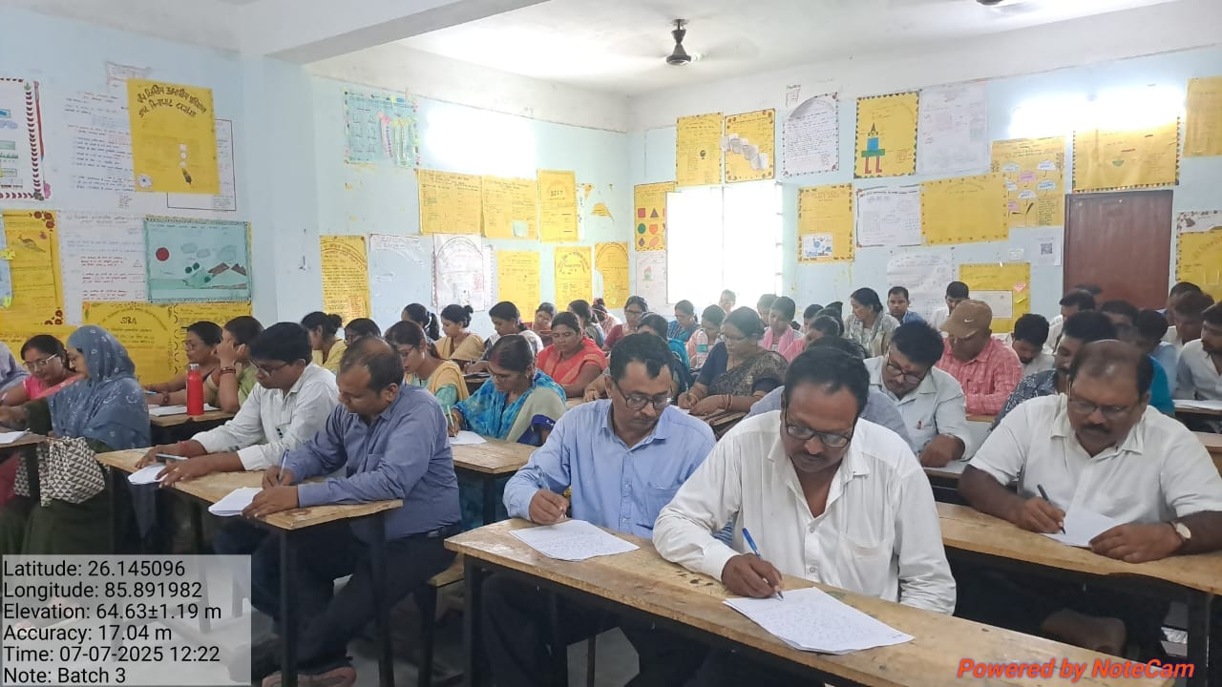
BATCH-3 (In Service Teachers Training 3-5)

Slide 15
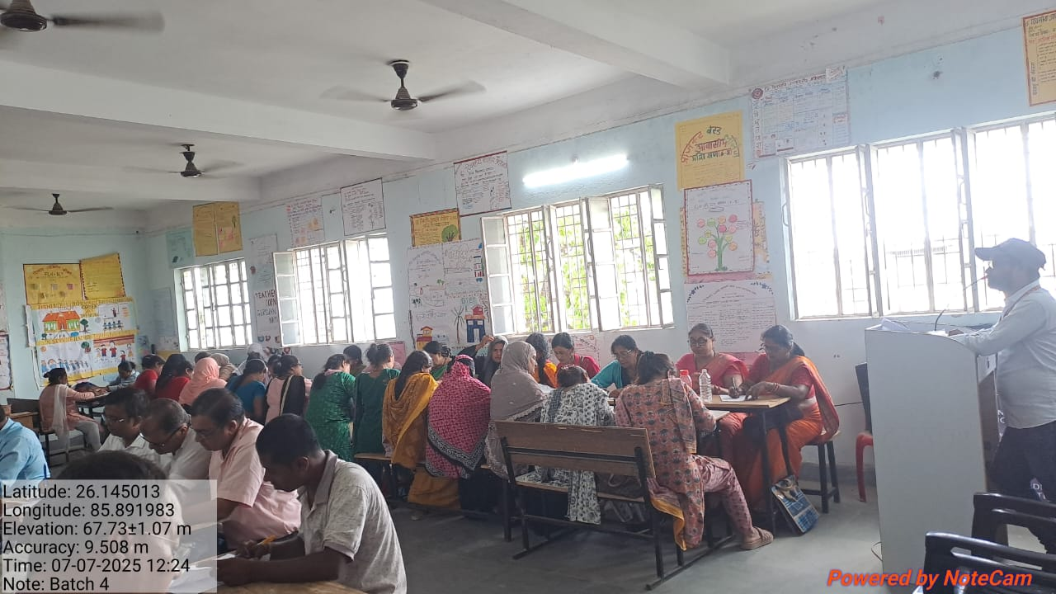
BATCH-4 (In Service Teachers Training 3-5)

Slide 16
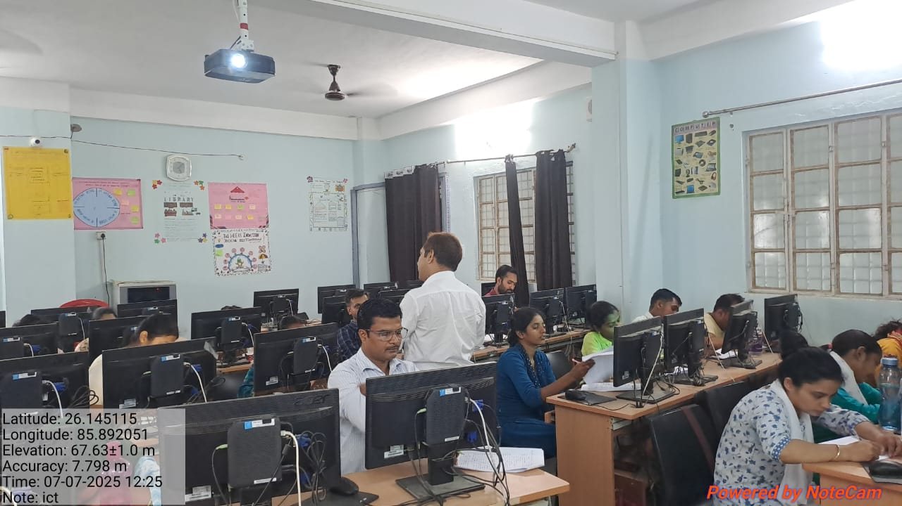
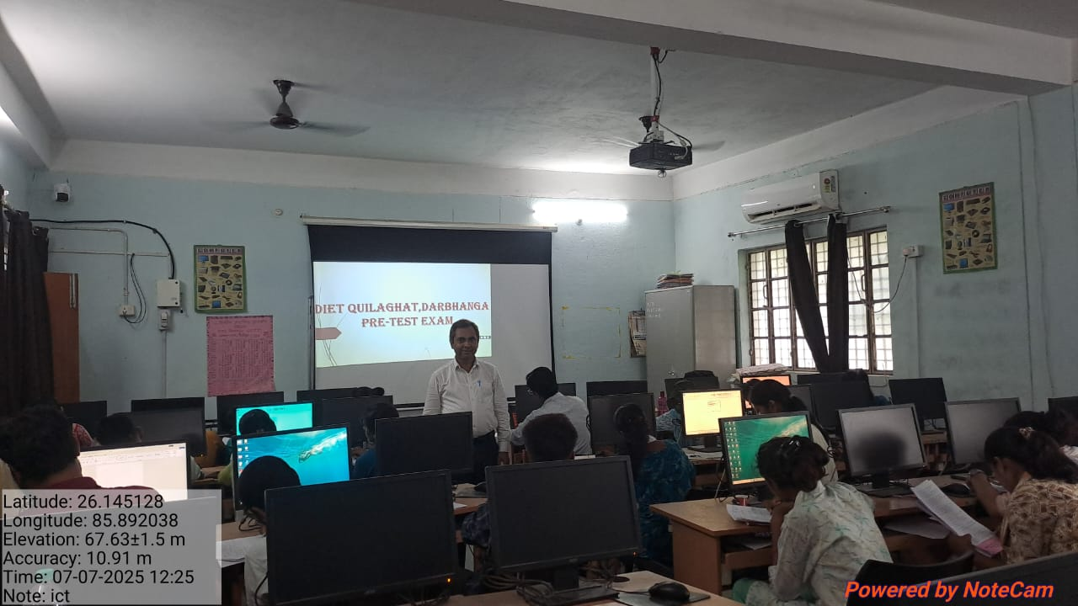
BATCH-5 (COMPUTER TEACHERS 6-8)

Slide 17
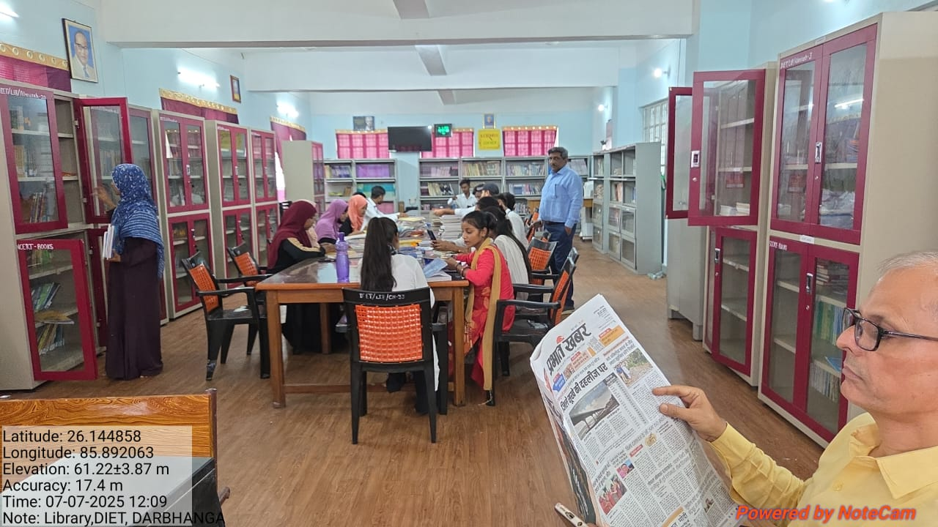
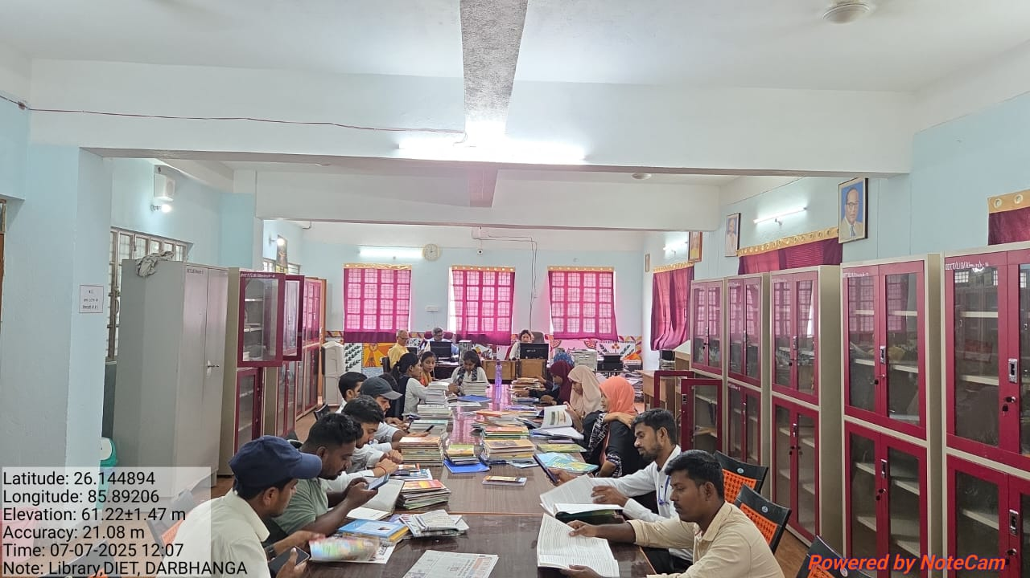
D.EL.ED SECOND YEAR (2024-26)

Slide 18
THANK YOU

