Slide 1
DISTRICT INSTITUTE OF EDUCATION AND TRAINING (DIET), QUILAGHAT DARBHANGA

Slide 2
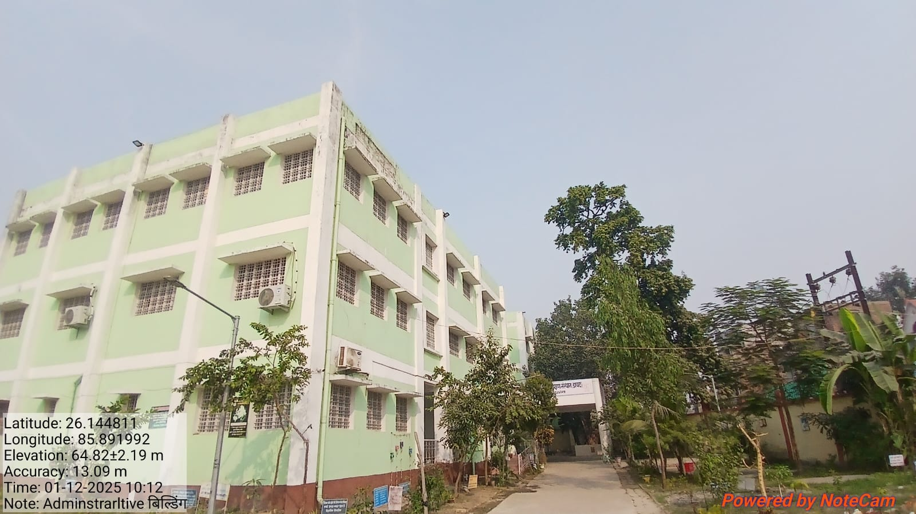
ADMINISTRATIVE BUILDING

Slide 3
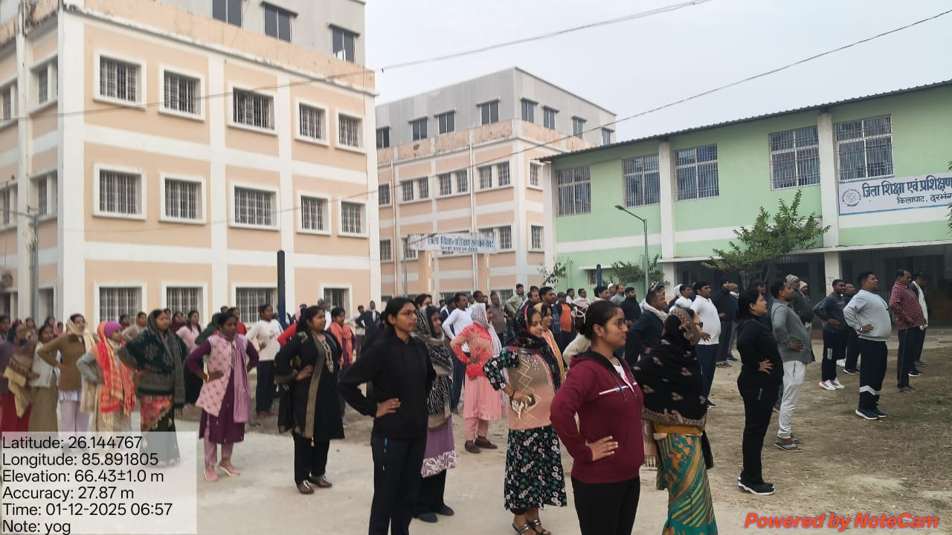
YOGA

Slide 4
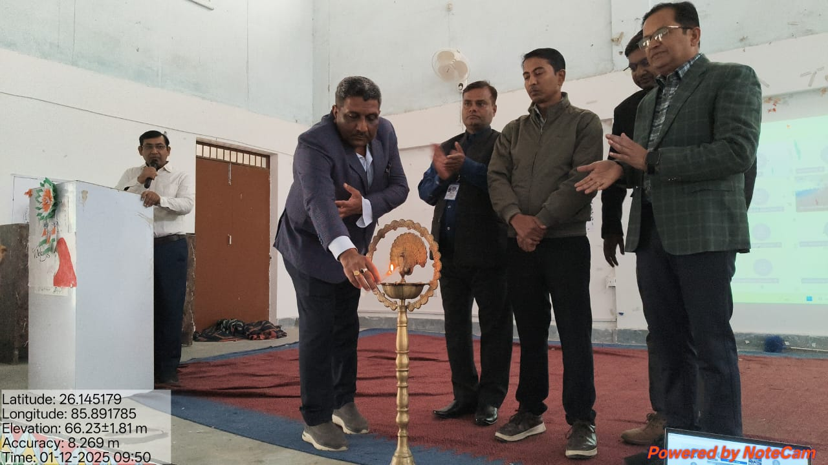
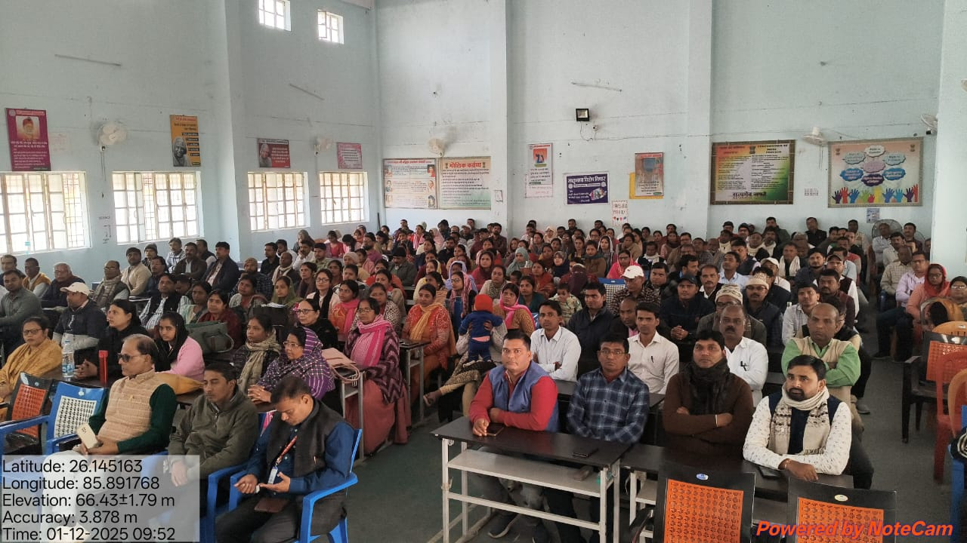
INAUGURATION

Slide 5
BASIC REPORT
DISTRICT INSTITUTE OF EDUCATION & TRAINING (DIET) QUILAGHAT DARBHANGA
In-Service Teachers training for Class 3 to 5 (FROM 01-12-2025 TO 05-12-2025)
1 .BASIC REPORT
A. DISTRICTWISE REPORT
 | SERIAL NO. | DISTRICT | BLOCK | N0. OF REQUISITION | NO. OF TEACHER REPORTED | NO. OF TEACHER ABSENT | NO OF BATCH | REGISTRATION STATUS | TRAINEES REPORTED AFTER 09:00 AM | ACTION TAKEN
 | 1 | DARBHANGA | JALE | 3 | 3 | 0 | 4 | 100% | 0 | 0
 | 2 |  | HAYAGHAT | 1 | 1 | 0
 | 3 |  | BAHERI | 1 | 1 | 0
 | 4 |  | BAHADURPUR | 3 | 3 | 0
 | 5 |  | DARBHANGA RURAL | 5 | 5 | 0
 | 6 |  | GHANSHYAMPUR | 74 | 70 | 4
 | 7 |  | KUSHESHWAR ASTHAN WEST | 88 | 69 | 19
 | 8 |  | GAURABAURAM | 2 | 2 | 0
 | 9 |  | KUSHESHWAR ASTHAN EAST | 40 | 31 | 9
 | 10 |  | DARBHANGA URBAN | 22 | 14 | 8
 |  | TOTAL |  | 239 | 199 | 40
B BLOCK WISE REPORT
 | SERIAL NO. |  | BLOCK | N0. OF REQUISITION | NO. OF TEACHER REPORTED | NO. OF TEACHER ABSENT | NO OF BATCH | REGISTRATION STATUS | TRAINEES REPORTED AFTER 09:00 AM | ACTION TAKEN
 | 1 | DARBHANGA | JALE | 3 | 3 | 0 | 4 | 100%
 | 2 |  | HAYAGHAT | 1 | 1 | 0 |  |  | 0 | 0
 | 3 |  | BAHERI | 1 | 1 | 0
 | 4 |  | BAHADURPUR | 3 | 3 | 0
 | 5 |  | DARBHANGA RURAL | 5 | 5 | 0
 | 6 |  | GHANSHYAMPUR | 74 | 70 | 4
 | 7 |  | KUSHESHWAR ASTHAN WEST | 88 | 69 | 19
 | 8 |  | GAURABAURAM | 2 | 2 | 0
 | 9 |  | KUSHESHWAR ASTHAN EAST | 40 | 31 | 9
 | 10 |  | DARBHANGA URBAN | 22 | 14 | 8
 |  | TOTAL |  | 239 | 199 | 40

Slide 6
BASIC REPORT
C. BATCH WISE REPORT
BATCH NO | BLOCK | ALLOTED | N0. OF REGISTERED | NO. OF TEACHER ABSENT
1 | JALE, HAYAGHAT,BAHERI, BAHADURPUR, DARBHANGA RURAL, GHANSHYAMPUR, KUSHESHWAR ASTHAN WEST, GAURABAURAM, KUSHESHWAR ASTHAN EAST, DARBHANGA URBAN | 65 | 51 | 14
2 | JALE, HAYAGHAT,BAHERI, BAHADURPUR, DARBHANGA RURAL, GHANSHYAMPUR, KUSHESHWAR ASTHAN WEST, GAURABAURAM, KUSHESHWAR ASTHAN EAST, DARBHANGA URBAN | 65 | 55 | 10
3 | JALE, HAYAGHAT,BAHERI, BAHADURPUR, DARBHANGA RURAL, GHANSHYAMPUR, KUSHESHWAR ASTHAN WEST, GAURABAURAM, KUSHESHWAR ASTHAN EAST, DARBHANGA URBAN | 45 | 36 | 9
4 | JALE, HAYAGHAT,BAHERI, BAHADURPUR, DARBHANGA RURAL, GHANSHYAMPUR, KUSHESHWAR ASTHAN WEST, GAURABAURAM, KUSHESHWAR ASTHAN EAST, DARBHANGA URBAN | 65 | 57 | 8
 | TOTAL | 239 | 199 | 41
 | 2. YOGA/PT ATTENDENCE
 | NO OF TRAINEES PRESENT | ABSENT | ACTION
 | 199 | 0 | 0

Slide 7
In-Service Teachers training for Class 3 to 5
ftyk f'k{kk ,oa izf'k{k.k laLFkku ¼Mk;V½
State Level FLN Training for Grade 3-5 Teachers-2025-26
Date | PT | 7.30 to 8.15 am | Session-I |  | Session-II | Session-Ill |  | Session-IV | Session-V |  | Session-VI
 | 06.00AM to 07.00AM |  | 10:00A.M - 11.00A.M | 11:00AM-11:15AM | 11:15A.M - 12.15P.M | 12:15P.M - 01.15P.M | 01:15P.M - 2.15P.M | 2:15P.M - 3.15P.M | 3:15P.M - 4.15P.M | 4:15P.M - 4.30P.M | 4:30P.M - 5.30P.M
Day-1 | PT & Yoga with Mindfullness & Meditation | Breakfast | Inauguration/Pre-Test/ Need & Significance of InService Training | Tea Break | Planning and Organizing Chetna Satra (Group Activity) | Concept and Understanding of Curriculum Goals (CGs), Competencies and Learning Dutcomes | Lunch Break | Analysis & Mapping of CGs, Competencies, LOs (Mapping of LOs through Textbooks Activity on the basis of NCF-SE) | 4 block approachof language teaching | Tea Break | Basics OfComputer
Mode of ToT
Day-2 | PT & Yoga with Mindfullness & Meditation |  | Pedagogy and classroom processes to improve Reading comprehension in Hindi |  | Working on Reading Comprehension using Textbook and Workbook & Presentation by teachers & their | Pedagogy and classroom processes to improve Writing Skills in Hindi |  | Working on Writing Skill using Textbook and Workbook & Presentation by teachers and their assessment | School Calendar (annual plan/ Monthly Plan/Daily Plan) |  | DIKSHA &e-lots Google Form,
Mode of ToT
Day-3 | PT & Yoga with Mindfullness & Meditation |  | Methods of Teaching Prose and and its Demonstration |  | Methods of Teaching Poetry and its Demonstration | Classroom Presentation by Individual Teachers selecting any Prose or Poetry in Hindi |  | Classroom Presentation by Individual Teachers selecting any Prose or Poetry in Hindi | FLN KIT |  | Using MS Word, MS Excel & Powerpoint in daily life
Mode of ToT
Day-4 | PT & Yoga with Mindfullness & Meditation |  | From Concrete to Abstract:Maths Teaching in Preparatory Stage |  | Methods of Teaching Numbers and its Operations and its Presentation | Methods of Teaching Shapes & Spatial Understanding and its Presentation |  | Methods of Teaching Measurement, data Handling, and Pattern and its Presentation | Assessment in Hindi & Maths (use of student learning tracker) |  | How much to rely on Chat Gpt/Open Al
Mode of ToT
Day-5 | PT & Yoga with Mindfullness & Meditation |  | Techniques and strategies (pedagogical processes) of teaching-learning Reading,Writing Skills In English |  | Mapping of learning outcomes with textbook content in English | Pedagogy and classroom processes to teach EVS |  | Familiarising with EVS textbooks, workbooks and Learning Outcomes | Daily feedback and post test |  | Validictory session
Mode of ToT

Slide 8
BATCH
 | BATCH | NAME | MOBILE NO
1 | BATCH-1 | DR. UMESH KUMAR RAJESH | 8340508688
 |  | SRIMATI RASHMI JAH | 8294190257
2 | BATCH-2 | SRIMATI KANCHAN KUMARI | 9334640508
 |  | SRI PANKAJ KUMAR | 8210319747
3 | BATCH-3 | DR. ROMILA TETE | 9934258548
 |  | DR. SHABBIR HUSSAIN | 9470437301
4 | BATCH-4 | SRI SANTOSH KUMAR | 9693247667
 |  | DR. PRADIP KUMAR PRASAD | 9334973981

Slide 9
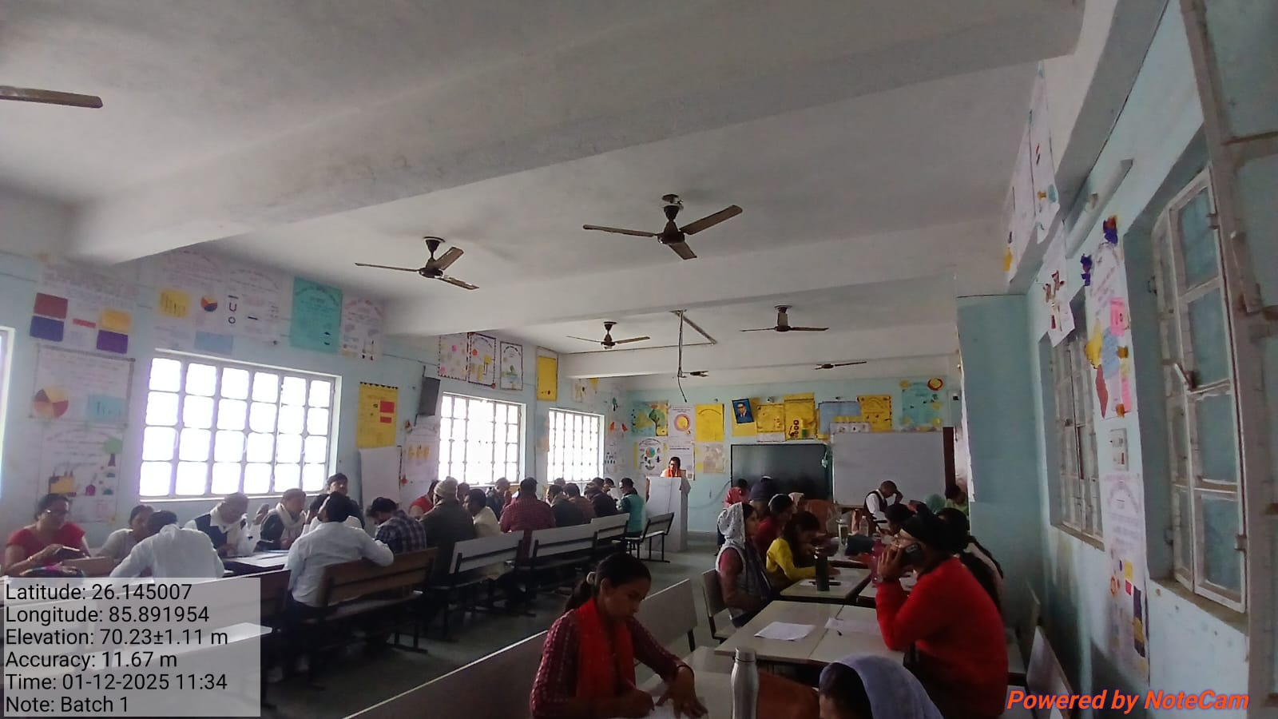
BATCH -1 (In-Service Teacher Training For Class 3-5)

Slide 10
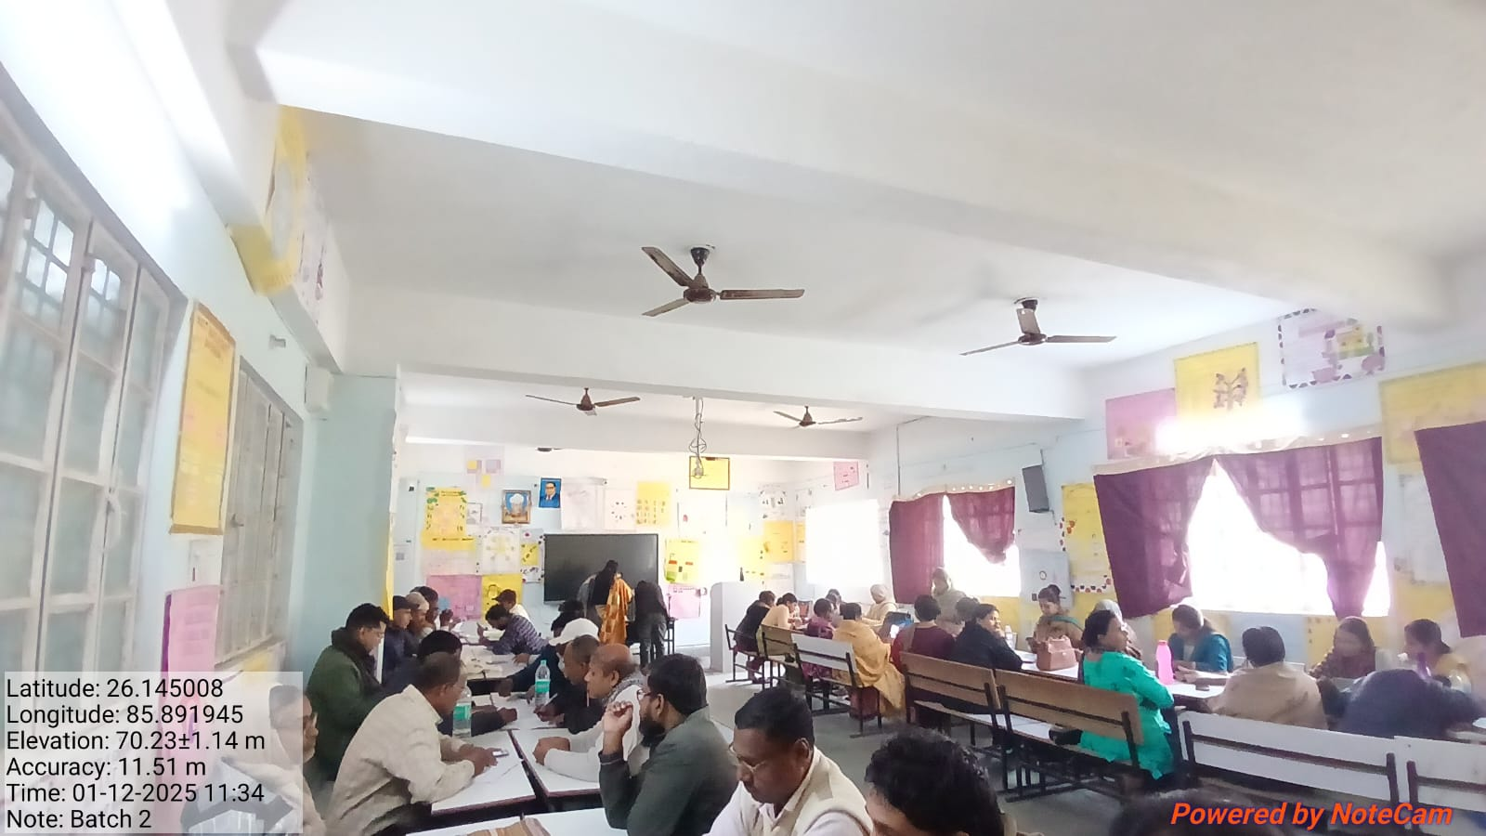
BATCH-2 (In-Service Teacher Training For Class 3-5)

Slide 11
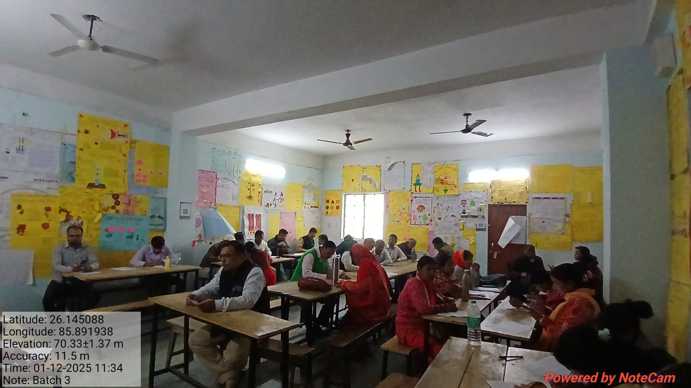
BATCH-3 (In-Service Teacher Training For Class 3-5)

Slide 12
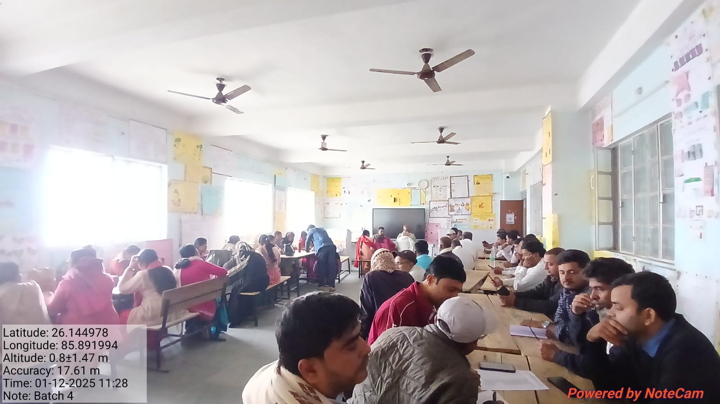
BATCH-4 (In-Service Teacher Training For Class 3-5)

Slide 13
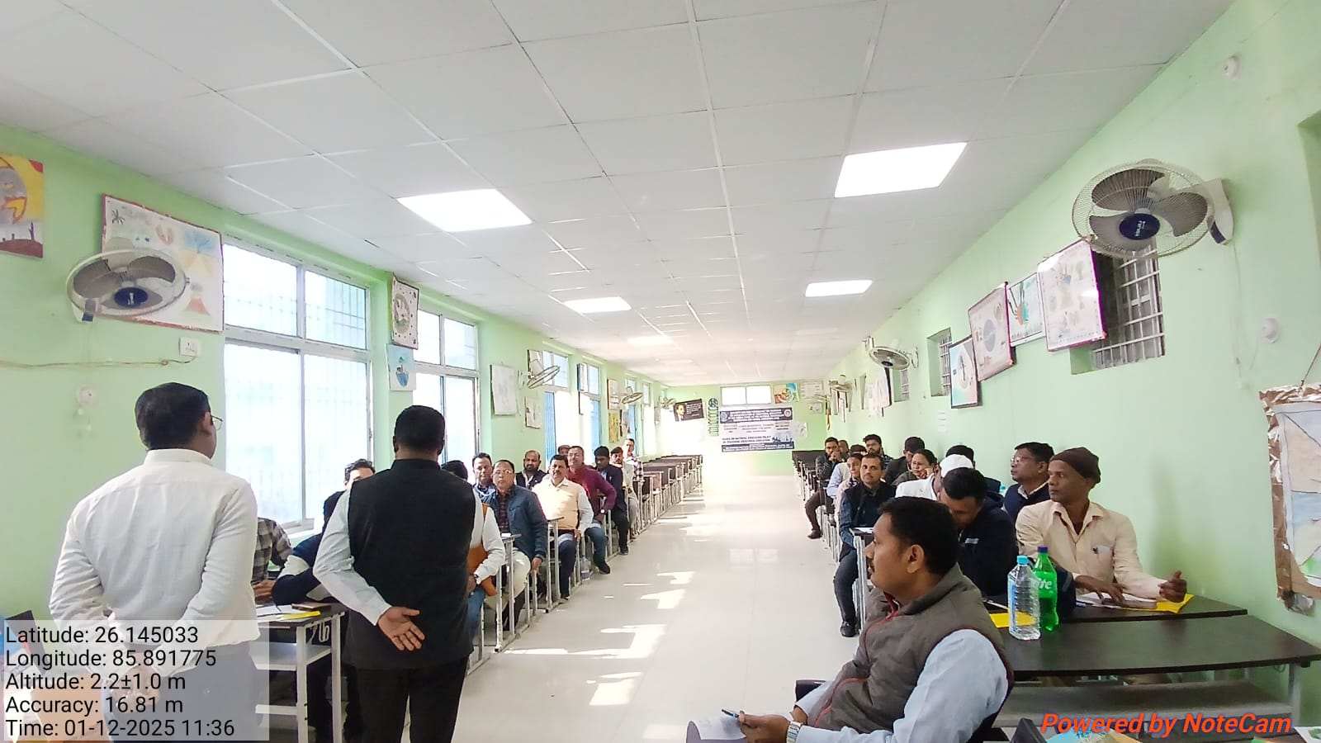
BATCH-5 (‘’Capacity building of Teachers on Implementation of vocational education at the Middle Stage as per the national Curriculum Framework for School Education 2023- reg'')

Slide 14
D.El.ED Second year (2024-26)
SEP-2

Slide 15
THANK YOU

